Slide 1
VFWCA
Department Officer
SharePoint Access Guide
ADMINISTRATOR GOAL
Give the right person
the right access
through the right role.
Administrator Training + Reference
Microsoft Entra • Security Groups • SharePoint
Current roster snapshot
September 9, 2026
Prepared for authorized VFWCA Global Administrators

Slide 2
START HERE
TRAINING + REFERENCE
What this guide is for
This deck is designed for people who have been entrusted with VFWCA tenant administration. It teaches the process, but it also serves as a reference when you need to make an access change months from now.
1 Sign in correctly
2 Manage people through roles
3 Protect the permission model
Know the difference between a normal email address, a Guest identity, and an internal @vfwca.onmicrosoft.com administrator account.
Search for an existing person first. If needed, invite an external user in Entra, then add that person to the correct VFWCA security group.
Remove people from role groups when duties change. Avoid direct SharePoint permissions, unnecessary Owners access, or deleting identities casually.
This guide assumes the administrator is authorized to make tenant-level changes. Global Administrator access is powerful and should be used deliberately.

Slide 3
ADMINISTRATOR SIGN-IN
CRITICAL
Know which identity you are using
VFWCA administrators may have more than one Microsoft identity. They are not interchangeable.
Normal email address
Guest identity
Administrator account
Example: bryant@vfwca.org
This is an email address. It is different from the internal VFWCA tenant administrator account.
Example:
bryant_vfwca.org#EXT#@vfwca.onmicrosoft.com
Entra creates this representation when an outside identity is invited into the tenant.
Example:
bryant@vfwca.onmicrosoft.com
This internal Member account is the account used for Global Administrator work.
@vfwca.org and @vfwca.onmicrosoft.com are different. For administrator work, sign in with the assigned @vfwca.onmicrosoft.com administrator account.

Slide 4
ADMINISTRATOR SIGN-IN
6 ACCOUNTS
Current Global Administrators
These are the internal accounts currently assigned the Global Administrator role. Use these accounts—not the person’s Guest identity—for administrator work.
Paragon
Salvador Cota
P
SC
Paragon@VFWCA.onmicrosoft.com
SCOTA@VFWCA.onmicrosoft.com
Deborah Johnson
Skip Miller
DJ
SM
QMCA@VFWCA.onmicrosoft.com
ADJCA@VFWCA.onmicrosoft.com
Tim Bryant
Paula Jansen
TB
PJ
bryant@VFWCA.onmicrosoft.com
PJansen@VFWCA.onmicrosoft.com
Administrator password reset contact: Salvador Cota — inspector@vfwca.org. If an administrator cannot sign in, another authorized Global Administrator must assist.

Slide 5

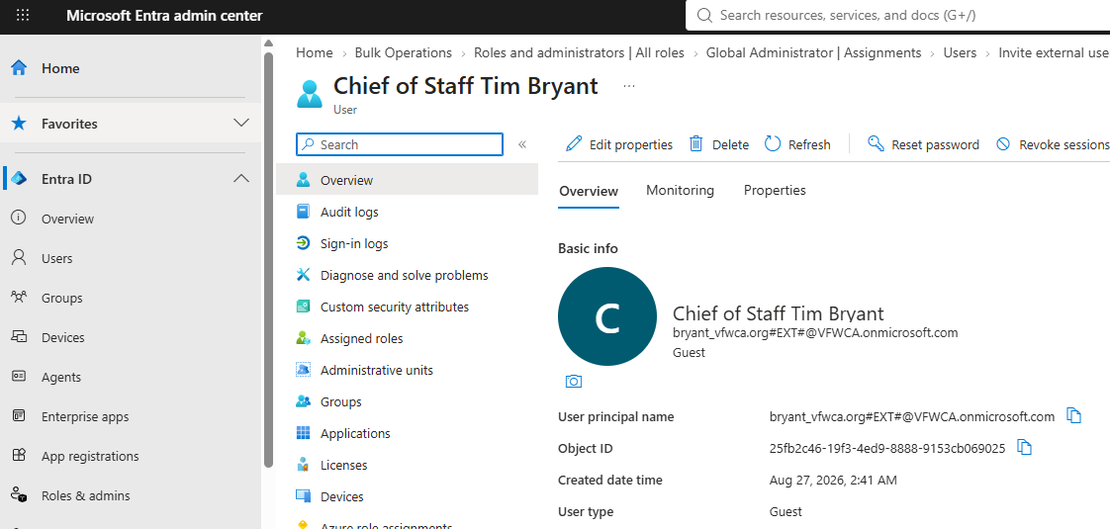
ADMINISTRATOR SIGN-IN
Administrator sign-in and password resets
1
Start with the administrator account
Use your assigned username ending in @vfwca.onmicrosoft.com.
2
Check the account shown in the upper-right corner
Correct: the administrator account is shown in the upper-right corner
If Microsoft has signed you in with a Guest or personal account, sign out or switch profiles before making administrative changes.
3
Use a separate browser profile when needed
This is often the easiest way to keep a normal/Guest identity separate from an administrator identity.
4
If you forget the administrator password
Ask another Global Administrator for a reset. For now, contact Salvador Cota at inspector@vfwca.org.
Different identity: a Guest object inside Entra
Do not reset, disable, or delete an account until you are certain which identity you are looking at. One person may have both a Guest object and a separate internal administrator account.

Slide 6
ADMINISTRATOR SIGN-IN
Administrator quick links
Use these four locations for different kinds of work. The PowerPoint and exported PDF keep these buttons clickable.
Microsoft Entra admin center
SharePoint admin center
Users • Guests • Security groups • Directory roles
Sites • SharePoint-wide settings • Site administration
Microsoft 365 admin center
VFWCA SharePoint
Tenant administration • Microsoft 365 services
Department • District • Post/Ship • Inspection pages
For routine access changes, Entra is the preferred starting point because VFWCA access is assigned through security groups.

Slide 7
HOW ACCESS WORKS
LAYMAN TERMS
The technical terms—in plain English
Microsoft Entra ID
User Principal Name (UPN)
VFWCA’s Microsoft “address book” for people, accounts, groups, and administrators.
The Microsoft username stored on an account. It often looks like an email address, but it is an identity field.
Guest user
Member account
A person who signs in with an identity that exists outside the VFWCA Microsoft tenant.
An account that belongs inside the VFWCA tenant. The Global Administrator accounts are Member accounts.
Security group
SharePoint permission
A role roster. Put people in the group; SharePoint gives the group access.
What a person or group may do: read, contribute/edit, or administer.
Think of it as: Entra keeps the people and role rosters; SharePoint honors those rosters at the doors.

Slide 8
HOW ACCESS WORKS
The VFWCA access model
The safest way to grant access is to change the person’s role membership—not to grant the person direct permissions on individual SharePoint sites.
1
2
3
4
Person
Entra identity
Security group
SharePoint
The real individual and their email
Guest or Member account
The VFWCA role roster
The site/page honors the role
Example: John is invited as a Guest → John is added to D06-Command Team → SharePoint gives that group Read access to District 06 and the Posts/Ships in its purview.
Changing the group membership is the normal administrative action. Deleting the person is a separate, much larger action.

Slide 9
THE SHAREPOINT ENVIRONMENT
Major VFWCA SharePoint locations
The environment is layered. Department-wide information sits at the top; District and Post/Ship sites sit underneath; specialized inspection tools support leadership and inspection work.
VFWCA Department Site
District Sites
Post / Ship Sites
Inspection Tools
District-specific information and collaboration. Each District has its own security roles.
Unit-specific sites, including inspection uploads and unit records where applicable.
Inspection Appointments • DEPT Leadership Tracker • Public Inspection Results
Root site: https://vfwca.sharepoint.com/

Slide 10
THE SHAREPOINT ENVIRONMENT
vfwca.sharepoint.com
Department Site
What it is
Who can do what
The Department-level communication site and the front door to the VFWCA SharePoint environment. It provides Department resources and links to District, Post/Ship, and inspection areas.
Dept Officers: Contribute on the Department site.
Inspectors: View.
D## and Post/Ship role groups: Read where the Department permission model grants it.
Administrator rule
Why this matters
Do not grant individual direct access when an established VFWCA security group already represents the role.
A group-based model makes role changes auditable and lets a successor inherit the right access by changing one group membership.
Open VFWCA SharePoint
Department root site

Slide 11
THE SHAREPOINT ENVIRONMENT
District Sites
Each District site is a collaboration layer between the Department and the Posts/Ships in that District.
D##-Contributors
D##-Command Team
Department-wide roles
District-level contributors. They can contribute/edit within their respective District site.
Example: D06-Contributors.
District Commanders and District Inspectors. They have Read access to their respective District and every Post/Ship within that District’s purview.
Dept Officers can Read all District sites. Inspectors can View all pages throughout the domain.
The role name is D##-Contributors (plural) in Entra.

Slide 12
THE SHAREPOINT ENVIRONMENT
Post / Ship Sites
#####-Contributor
District oversight
Department oversight
The role for people who need to contribute to one specific Post or Ship site.
Example: 10965-Contributor.
This is the normal place for the Post/Ship Commander, Quartermaster, Adjutant, or other authorized unit user.
The matching D##-Command Team has Read access across the Posts/Ships in that District’s purview. This supports District Commander and District Inspector oversight.
Dept Officers have Read access to all sites. Inspectors can View all pages across the entire VFWCA SharePoint domain.
A Post user should not be placed in another Post’s contributor group unless there is an intentional, authorized reason.

Slide 13
MAJOR PAGES
Inspection Appointments
Purpose
Access model
The working page/list for scheduled inspection appointments and inspector assignments. It lets leadership see when Districts are scheduled and which inspectors have been assigned.
Dept Officers: Contribute
Inspectors: View as part of domain-wide inspector access
Other users: access only as granted by the established SharePoint permission model
Use the role groups to control access. Do not solve an access problem by giving a person direct permissions to the list unless there is a documented exception.

Slide 14
MAJOR PAGES
DEPT Leadership Tracker
Purpose
Access model
The leadership-facing master tracker for inspection status and results. Department leadership updates the authoritative record here.
Dept Officers: Contribute
Inspectors: View
This is a leadership tool; edits should be deliberate because downstream public information is automated from this source.
Treat the DEPT Leadership Tracker as the source of truth for the public inspection status workflow.

Slide 15
MAJOR PAGES
Public Inspection Results
Purpose
Access model
The public-facing inspection results/status page. It presents the information intended for broader viewing without exposing the full leadership tracker.
Dept Officers: Contribute
District Commanders: Read
Inspectors: View
The page has intentionally narrower permissions than ordinary Department content.
DEPT Leadership
Tracker
Automated update
within ~5 minutes
Public Inspection
Results
If the public result does not change immediately after a leadership update, allow up to five minutes for the automation before troubleshooting.

Slide 16
ROLE-BASED ACCESS
PERMISSION MATRIX
What each VFWCA role does
ROLE | WHO IT REPRESENTS | NORMAL ACCESS
#####-Contributor | Authorized Post/Ship users | Contribute to that specific Post/Ship site; read broader areas where the site model grants it.
D##-Contributors | Authorized District contributors | Contribute/edit within that District site.
D##-Command Team | District Commanders + District Inspectors | Read their District and every Post/Ship in that District’s purview.
Dept Officers | Department officers/staff designated for Department access | Read all sites; Contribute on Department Site, Inspection Appointments, Public Inspection Results, and DEPT Leadership Tracker.
Inspectors | Department inspection team / authorized inspectors | View all pages across the entire VFWCA SharePoint domain. Membership must be audited periodically.
Global Administrator is not one of these content roles. It is a tenant-level administrator role. Do not use Global Administrator as a substitute for proper SharePoint role membership.

Slide 17
ADDING EXTERNAL USERS
What is an external user?
For VFWCA, an external user is someone who does not have an internal @vfwca.onmicrosoft.com account.
They keep their outside identity
VFWCA creates a Guest object
The role creates access
The person may use Gmail, Yahoo, Outlook, a VFWCA.org mailbox, another organization’s Microsoft account, or another supported identity. VFWCA does not create a new everyday mailbox for them.
Entra creates an identity record inside the VFWCA tenant so the person can be placed into VFWCA role groups and recognized by SharePoint.
Inviting the person alone does not automatically give useful SharePoint access. The person must be assigned to the correct VFWCA security group.
Always search Entra first. Creating another Guest for an email that already exists can produce confusing duplicate identities and access problems.

Slide 18
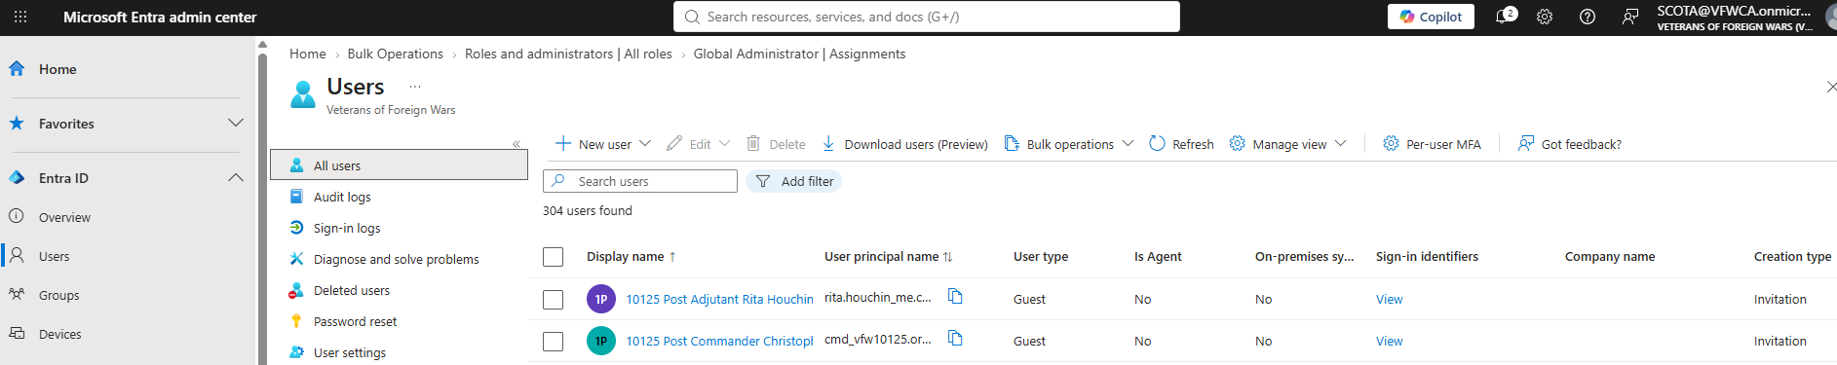
ADDING EXTERNAL USERS
Step 1 — Search before you invite
Microsoft Entra admin center → Users → All users
Search for the person by the email address they gave you. If a Guest already exists, use that existing identity instead of creating a second one.
1
Open Entra → Users → All users
2
Search the outside email
3
Confirm the identity
Use the Search users box.
Try the actual email address first.
Check display name, email, User type, and creation type.

Slide 19
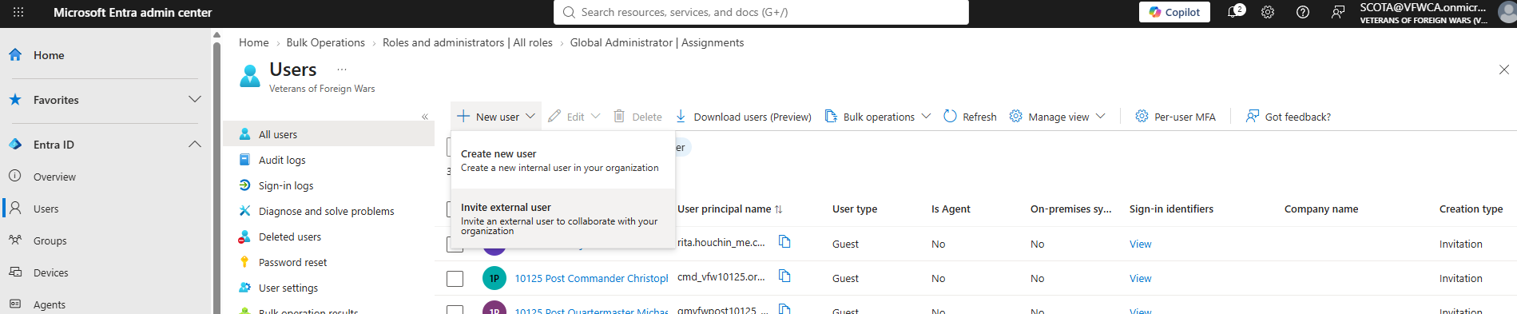
ADDING EXTERNAL USERS
Step 2 — Invite the external user
Users → New user → Invite external user
1
Choose New user.
2
Select Invite external user — not Create new user.
3
Enter the person’s actual outside email address and a recognizable display name.
Create new user makes an internal account. Invite external user creates the Guest object used for outside identities.

Slide 20
ADDING EXTERNAL USERS
UPN FORMAT
How the Guest username changes
The person still signs in with their real outside identity. Entra also gives the Guest a VFWCA-side User Principal Name (UPN).
Guest UPN inside VFWCA
Outside email
person_gmail.com#EXT#
@vfwca.onmicrosoft.com
person@gmail.com
@ becomes _
#EXT# marks a Guest
Tenant suffix
Inside the Guest UPN, the @ in the outside email is represented by an underscore.
The #EXT# portion is a strong visual clue that you are looking at an invited external identity.
The VFWCA Guest UPN now ends in @vfwca.onmicrosoft.com.
Do not confuse the Guest UPN with the administrator account. A person may have both.

Slide 21
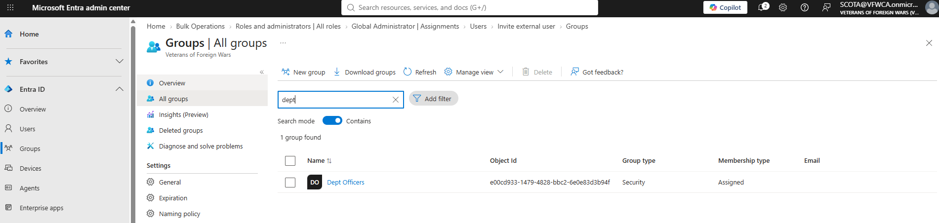
ASSIGNING ROLES
Step 3 — Find the correct role group
Entra → Groups → All groups → search the exact role
Search for the exact VFWCA role name. Confirm Group type = Security and Membership type = Assigned.
#####-Contributor
D##-Contributors
D##-Command Team
Dept Officers
Inspectors
One Post/Ship
One District — edit
District Commander / District Inspector — read
Department-wide officer role
All-domain inspection visibility

Slide 22
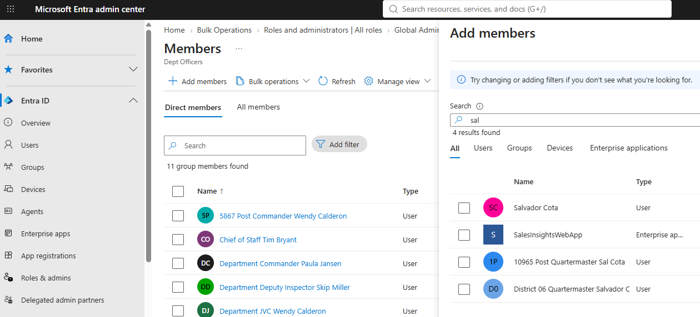
ASSIGNING ROLES
Step 4 — Add the person to the role
Security group → Members → Add members
1
Click Add members.
2
Search for the person.
3
Select the correct identity, then complete the Add action.
If search returns multiple Salvador/John/Tim/etc. identities, verify the email and User type before selecting.

Slide 23
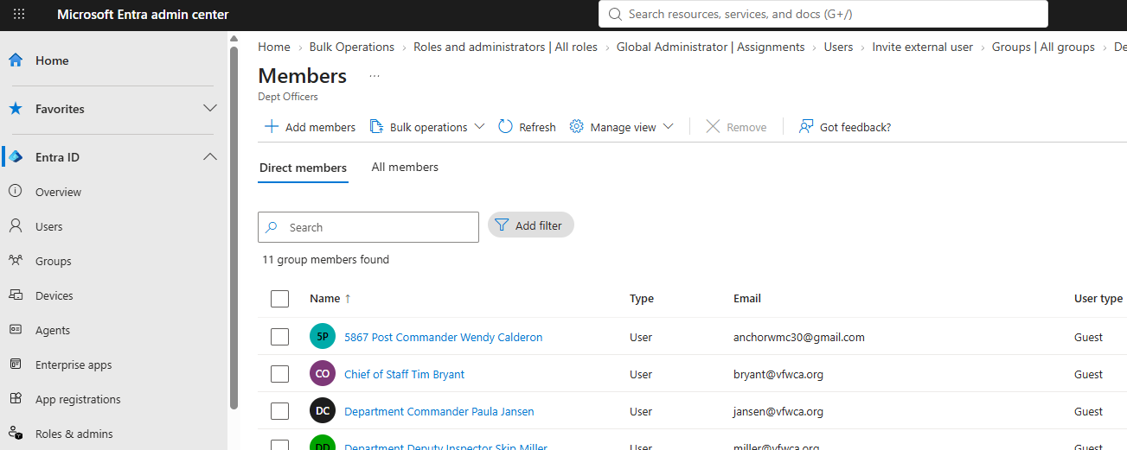
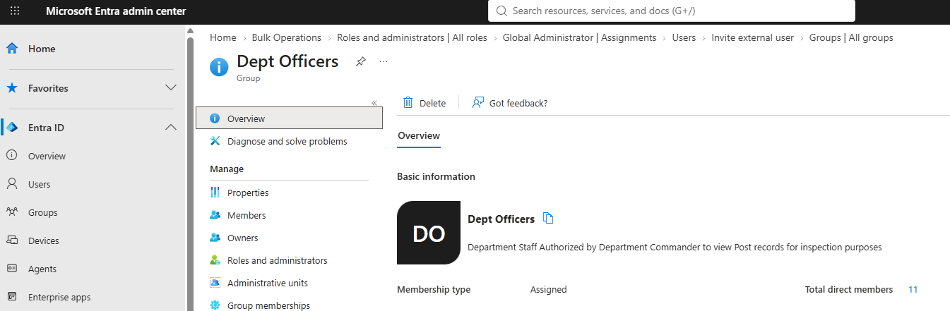
ASSIGNING ROLES
Step 5 — Confirm the role membership
Example security group overview
Example Members page
Confirm the group
Confirm the person
Then test access
Make sure the group name is the intended VFWCA role—not a similarly named group.
Verify the person appears in Direct members with the expected email address.
If needed, ask the user to sign in again or allow normal Microsoft propagation before changing more permissions.

Slide 24
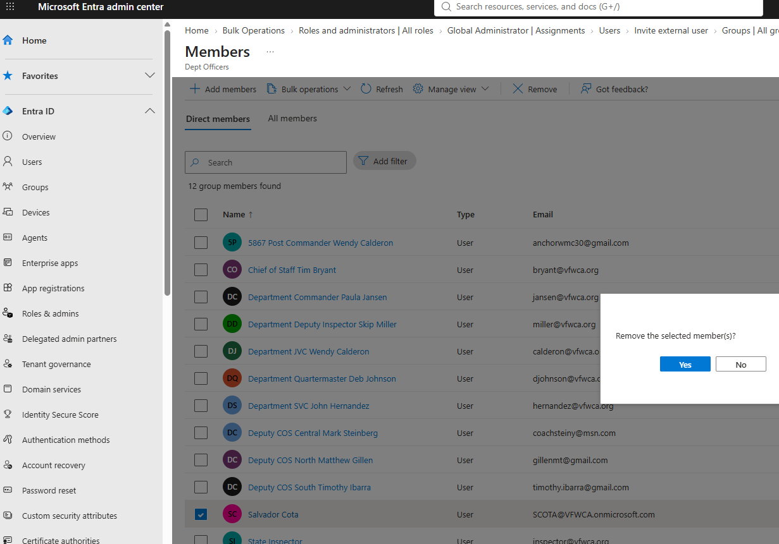
REMOVING ACCESS
Removing a person from a role
Security group → Members → select the person → Remove → confirm
For a normal role change, remove the person from the security group. This leaves the Entra identity available for any other legitimate VFWCA role memberships.

Slide 25
REMOVING ACCESS
Remove from the role vs. delete the user
NORMAL ACTION: Remove from the group
LARGER ACTION: Delete the user
Use this when the person changes offices, no longer needs a specific site, or should lose one role while keeping another.
Effect: only that group-based access is removed.
The Guest/Member account stays in Entra.
Use this only when the identity should no longer exist in the VFWCA tenant.
Effect: the Entra identity is removed and access tied to that identity is lost.
Deletion is not necessary for an ordinary office/role change.
Before deleting a user, check whether the person belongs to other VFWCA security groups or still has an authorized reason to access the tenant.

Slide 26
ROLE GOVERNANCE
AUDIT PERIODICALLY
The Inspectors role requires special attention
Why it matters
Audit questions
Current snapshot
Members of the Inspectors security group can view all pages across the entire VFWCA SharePoint domain. That is broader visibility than a normal Post, District, or Department role.
• Is this person still an authorized inspector?
• Does the appointment still require domain-wide visibility?
• Is the email/account still correct?
• Should the person be removed from Inspectors but remain in another role?
39 membership records are currently in the Inspectors group. One of those is the internal Member account “Paragon”; the others are Guest identities.
Use the appendix roster as the September 9, 2026 baseline.
Do not assume the Inspectors group is self-maintaining. Appointment changes must be reflected in Entra.

Slide 27
ROLE GOVERNANCE
GUARDRAILS
Do not do these things
×
Do not give individuals direct SharePoint permissions when a security group already exists for the role.
×
Do not make routine users Site Owners or administrators simply to “make access work.”
×
Do not delete a Guest just because the person is leaving one office—remove or change role membership first.
×
Do not casually alter inheritance or unique page permissions; changes can expose or hide content unexpectedly.
×
Do not place a Post user in another Post’s contributor group without a specific, authorized reason.
×
Do not confuse Global Administrator with ordinary SharePoint content access.
×
Do not change the Department/District permission structure without understanding what the security groups are intended to do.
×
Do not add or retain Inspectors without periodic review of whether domain-wide visibility is still justified.

Slide 28
TROUBLESHOOTING
Common problems and the first thing to check
SYMPTOM | FIRST CHECK | LIKELY NEXT STEP
Admin center says you lack permission | Which account is shown in the top-right corner? | Sign in with the @vfwca.onmicrosoft.com administrator account.
A person cannot see a site | Is the person in the correct security group? | Fix group membership before adding direct SharePoint permissions.
Search finds two versions of the same person | Compare email, UPN, User type, and display name. | Use the existing correct identity; avoid creating another Guest.
Access was removed but still appears briefly | Microsoft services may need time to reflect changes. | Allow normal propagation, then retest.
Public Inspection Results did not change immediately | Was DEPT Leadership Tracker updated correctly? | Allow up to ~5 minutes for the automated update.
An admin forgot their password | Is another Global Administrator available? | Contact Salvador Cota at inspector@vfwca.org for the current reset process.

Slide 29
ROLE GOVERNANCE
Administrator maintenance checklist
✓
Before adding anyone
Search Entra for the email. Confirm whether an identity already exists.
✓
When an office changes
Remove the person from the old role group; add the new role only if authorized.
✓
When an inspector appointment changes
Review Inspectors membership and remove domain-wide visibility when no longer needed.
✓
When a user reports access trouble
Check the identity and security-group membership before touching SharePoint permissions.
✓
When another admin cannot sign in
Verify they are using their @vfwca.onmicrosoft.com account; coordinate a reset with another Global Administrator.
✓
Before making structural SharePoint changes
Understand inheritance, unique permissions, and which Entra groups currently provide access.
The guiding rule: manage access at the role group whenever possible. That keeps the permission model understandable for the next administrator.

Slide 30
APPENDIX
SEP 9, 2026
Current VFWCA access roster snapshot
6
Global Administrators
11
Dept Officers
39
Inspectors
9
District Command Team groups
9
District Contributor groups
72
Post/Ship Contributor groups
268 group-membership records across 93 security groups with at least one user member; 226 unique user objects.
The following slides are a point-in-time reference. Always verify current Entra membership before making a consequential access decision.

Slide 31
APPENDIX
CURRENT ROSTER
Dept Officers — current members
Name | Email / sign-in identity
5867 Post Commander Wendy Calderon | anchorwmc30@gmail.com
Chief of Staff Tim Bryant | bryant@vfwca.org
Department Commander Paula Jansen | jansen@vfwca.org
Department Deputy Inspector Skip Miller | miller@vfwca.org
Department JVC Wendy Calderon | calderon@vfwca.org
Department Quartermaster Deb Johnson | djohnson@vfwca.org
Department SVC John Hernandez | hernandez@vfwca.org
Deputy COS Central Mark Steinberg | coachsteiny@msn.com
Deputy COS North Matthew Gillen | gillenmt@gmail.com
Deputy COS South Timothy Ibarra | timothy.ibarra@gmail.com
State Inspector | inspector@vfwca.org

Slide 32
APPENDIX
CURRENT ROSTER
Inspectors — current members (1 of 3)
Name | Email / sign-in identity
2814 Post Commander JonPaul Bockman | jpmb1172@gmail.com
3173 Post Quartermaster Joseph Koontz | JoeKoontzJr@gmail.com
5948 Post Adjutant Carrie Morgan | careinajean@gmail.com
7263 Post Commander Stephen Curtin | sjcurtin1946@gmail.com
7264 Post Quartermaster Jonathan Pellior | john.pellior@gmail.com
9148 Post Adjutant Rene Macias | renmacias@gmail.com
9148 Post Commander Pedro Hernandez | ph8762@pm.me
9578 Post Adjutant Eugene Stokes | trainnuts@aol.com
9896 Post Commander Manuel Inacio | manther2007@gmail.com
Chief of Staff Tim Bryant | bryant@vfwca.org
Department Deputy Inspector Charles Golden | charlesgolden69@gmail.com
Department Deputy Inspector Chris Harvey | christopher.harvey.vfw1@outlook.com
Department Deputy Inspector Cody Frazier | cody@foxtrotcomputing.com

Slide 33
APPENDIX
CURRENT ROSTER
Inspectors — current members (2 of 3)
Name | Email / sign-in identity
Department Deputy Inspector Darrol Prill | lorrad@aol.com
Department Deputy Inspector Hector Torres | Hectorvfwd13@gmail.com
Department Deputy Inspector Ivan TorreBlanca | ivan.torreblanca1123@gmail.com
Department Deputy Inspector Jack Napier | grapemc55@gmail.com
Department Deputy Inspector Jason Gaines | jgainesvfw@gmail.com
Department Deputy Inspector Lyle Ducheneaux | xngh58@yahoo.com
Department Deputy Inspector Margaret Cardiel | maspicosa20@gmail.com
Department Deputy Inspector Mike Croy | mcroy2@gmail.com
Department Deputy Inspector Paul Petersen | pup81073@hotmail.com
Department Deputy Inspector Rick Boughner Jr. | rjb.usmc@gmail.com
Department Deputy Inspector Rick Linares | rlinares57@yahoo.com
Department Deputy Inspector Robert Hoffman | bob02builder@yahoo.com
Department Deputy Inspector Ryan Gondek | ryan.gondek@gmail.com

Slide 34
APPENDIX
CURRENT ROSTER
Inspectors — current members (3 of 3)
Name | Email / sign-in identity
Department Deputy Inspector Samana Tinsley | samana0216@yahoo.com
Department Deputy Inspector Selso Cavazos | silverbear126195@comcast.net
Department Deputy Inspector Shadic Anderson | shadicanderson@gmail.com
Department Deputy Inspector Skip Miller | miller@vfwca.org
Department Deputy Inspector Stacey Carpenter | vfw4647antca@gmail.com
Department Deputy Inspector Steve Milano | milano@vfwca.org
Department Deputy Inspector Terry Murphy | terry.murphy2@comcast.net
Department Quartermaster Deb Johnson | djohnson@vfwca.org
Deputy COS Central Mark Steinberg | coachsteiny@msn.com
District 04 Commander Rob Cancio | r.cancio29@gmail.com
District 06 Commander Robbie Normand | robbie.normand@gmail.com
Paragon | Paragon@VFWCA.onmicrosoft.com
State Inspector | inspector@vfwca.org

Slide 35
APPENDIX
CURRENT ROSTER
District Command Teams — current members
Role group | Member | Email
D01-Command Team | District 01 Commander John Carson | john.r.carson@gmail.com
D02-Command Team | District 02 Commander John L. Carson | califcarson@cox.net
D04-Command Team | District 04 Commander Rob Cancio | r.cancio29@gmail.com
D05-Command Team | District 05 Commander Regina Troglin | Reginatroglin.vfw@gmail.com
D06-Command Team | District 06 Commander Robbie Normand | robbie.normand@gmail.com
D10-Command Team | District 10 Commander Mike Gilmore | mikegilmore.579@gmail.com
D11-Command Team | District 11 Commander Jorge Galvez | Jorgegalvez80@gmail.com
D16-Command Team | District 16 Commander Shawn Hevener | shawnhevener@gmail.com
D17-Command Team | Deputy COS North Matthew Gillen | gillenmt@gmail.com

Slide 36
APPENDIX
CURRENT ROSTER
District Contributors — current members
Role group | Member | Email
D01-Contributors | District 01 Commander John Carson | john.r.carson@gmail.com
D02-Contributors | District 02 Commander John L. Carson | califcarson@cox.net
D02-Contributors | Marcia Kuehl | ma.kuehl@gmail.com
D04-Contributors | District 04 Commander Rob Cancio | r.cancio29@gmail.com
D05-Contributors | District 05 Commander Regina Troglin | Reginatroglin.vfw@gmail.com
D06-Contributors | District 06 Commander Robbie Normand | robbie.normand@gmail.com
D06-Contributors | District 06 Quartermaster Salvador Cota | salcota@gmail.com
D10-Contributors | District 10 Commander Mike Gilmore | mikegilmore.579@gmail.com
D11-Contributors | District 11 Commander Jorge Galvez | Jorgegalvez80@gmail.com
D16-Contributors | District 16 Commander Shawn Hevener | shawnhevener@gmail.com
D17-Contributors | 10125 Post Adjutant Rita Houchin | rita.houchin@me.com
D17-Contributors | Deputy COS North Matthew Gillen | gillenmt@gmail.com
D17-Contributors | District 17 Adjutant | adjvfwcadist17@gmail.com
D17-Contributors | District 17 Quartermaster | qmvfwcadist17@gmail.com

Slide 37
APPENDIX
CURRENT ROSTER
Post / Ship Contributors — current members (1 of 13)
Role group | Member | Email
52-Contributor | 52 Post Adjutant Samuel Pachuca | samandfloella@yahoo.com
52-Contributor | 52 Post Commander Tomas Bermudez Dimas | bermudezto14@gmail.com
52-Contributor | 52 Post Quartermaster Arthur Rodriguez | Art_Rodriguez74@yahoo.com
233-Contributor | 233 Post Adjutant Jerry Walker | kilo37doc@gmail.com
233-Contributor | 233 Post Commander James Lillibridge | vfwpost233@verizon.net
233-Contributor | 233 Post Quartermaster Arturo Aguilar | aguilar78a@msn.com
1051-Contributor | 1051 Post Adjutant David Eddy | daeddy75th@gmail.com
1051-Contributor | 1051 Post Commander Stephen Meece | meeces2pieces@yahoo.com
1051-Contributor | 1051 Post Quartermaster Gregory Hughes | greghughes19@gmail.com
1351-Contributor | 1351 Post Adjutant George Miller | m_gart@bellsouth.net
1351-Contributor | 1351 Post Commander Oliver Greenwood | oagwood@gmail.com
1351-Contributor | 1351 Post Quartermaster Arthur Gomez | gomezcowboys94@gmail.com
1512-Contributor | 1512 Post Adjutant Jeffrey Sexton | longhorn_scott@hotmail.com
1512-Contributor | 1512 Post Commander Robert Engler | dartman1066@aol.com
1512-Contributor | 1512 Post Quartermaster Michael Phillips | vfwmcchief@gmail.com

Slide 38
APPENDIX
CURRENT ROSTER
Post / Ship Contributors — current members (2 of 13)
Role group | Member | Email
1513-Contributor | 1513 Post Adjutant Stephen Walker | stephen.a.walker1@outlook.com
1513-Contributor | 1513 Post Commander Christina Cruz | cruzc.usaf.vet@gmail.com
1513-Contributor | 1513 Post Quartermaster Christopher Anderson | runalot70@gmail.com
1525-Contributor | 1525 Post Adjutant Carin Musak | carin.musak@gmail.com
1525-Contributor | 1525 Post Commander Leonard Caulder | caulder99@yahoo.com
1525-Contributor | Deputy COS Central Mark Steinberg | coachsteiny@msn.com
1679-Contributor | 1679 Post Adjutant Mark Thies | mtyd2@aol.com
1679-Contributor | 1679 Post Commander | dupont@usa.com
1679-Contributor | 1679 Post Quartermaster Pablo Paredes | pablo.paredes1@gmail.com
1747-Contributor | 1747 Post Adjutant | zlibert1@yahoo.com
1747-Contributor | 1747 Post Commander Robert Fager | cmd@vfw1747.org
1747-Contributor | 1747 Post Quartermaster Zane Libert | zanel2@yahoo.com
1924-Contributor | 1924 Post Adjutant Jacquelyn Gibson | jackiesamuel84@gmail.com
1924-Contributor | 1924 Post Commander Timothy Kirk | commandervfwpost1924@gmail.com
1924-Contributor | 1924 Post Quartermaster Keith Krebs | keith.krebs01@gmail.com

Slide 39
APPENDIX
CURRENT ROSTER
Post / Ship Contributors — current members (3 of 13)
Role group | Member | Email
1956-Contributor | 1956 Post Adjutant Matthew Gilmore | matthew.a.gilmore@gmail.com
1956-Contributor | 1956 Post Commander Michael Cano | canom1@msn.com
1956-Contributor | 1956 Post Quartermaster Jose Lugo | jmlugo8511@gmail.com
2075-Contributor | Deputy COS South Timothy Ibarra | timothy.ibarra@gmail.com
2266-Contributor | 2266 Post Adjutant Anthony Looney | looneyanthonyjoaquin@gmail.com
2266-Contributor | 2266 Post Commander Gerald Woodbeck | bmes2000.jw@gmail.com
2266-Contributor | 2266 Post Quartermaster Alfredo Medina | medinaa11b@gmail.com
2275-Contributor | 2275 Post Commander Edward McCoy | edmccoy60@yahoo.com
2275-Contributor | 2275 Post Quartermaster Jerry Koehmlein | koehmleinj@gmail.com
2323-Contributor | 2323 Post Adjutant John Steinhauer | john.steinhauer@gmail.com
2323-Contributor | 2323 Post Commander Jonathan O'Sullivan | osullivan.jon@gmail.com
2323-Contributor | 2323 Post Quartermaster Glenn Gates | gates42837@gmail.com
2381-Contributor | 2381 Post Commander Ronald Wood | rwooddistrict826@yahoo.com
2381-Contributor | 2381 Post Quartermaster Cecil Glenn | lmbrjck43@gmail.com
2487-Contributor | 2487 Post Adjutant William Winch | wmwinch70@gmail.com

Slide 40
APPENDIX
CURRENT ROSTER
Post / Ship Contributors — current members (4 of 13)
Role group | Member | Email
2487-Contributor | 2487 Post Commander Michael Hughes | myknsal@prodigy.net
2487-Contributor | 2487 Post Quartermaster Robert Strauch | rstrauch1@me.com
2814-Contributor | 2814 Post Commander JonPaul Bockman | jpmb1172@gmail.com
2814-Contributor | 2814 Post Quartermaster Brandon Phillips | slofire2@gmail.com
2922-Contributor | 2922 Post ADJ/QM Laughlin | rlaughlin1@msn.com
2922-Contributor | 2922 Post Commander Jim Duty | jim.duty@gmail.com
3010-Contributor | 3010 Post Adjutant Lindsay Riddick-Liu | lriddickliu@gmail.com
3010-Contributor | 3010 Post Commander Dennis Reynolds | OLDNAVYLDO@AOL.COM
3010-Contributor | 3010 Post Quartermaster Charles Barnhart | packerfan704@hotmail.com
3173-Contributor | 3173 Post Adjutant Daniel Jennings | daniel.jennings1.dj@gmail.com
3173-Contributor | 3173 Post Commander Michael Lynn | a905h@aol.com
3173-Contributor | 3173 Post Quartermaster Joseph Koontz | JoeKoontzJr@gmail.com
3199-Contributor | 3199 Post Adjutant Steven Estrada | work.sestrada@yahoo.com
3199-Contributor | 3199 Post Commander Patricia Rosales | greasesister@yahoo.com
3199-Contributor | 3199 Post Quartermaster Kevin Aqueche | k_9keech@yahoo.com

Slide 41
APPENDIX
CURRENT ROSTER
Post / Ship Contributors — current members (5 of 13)
Role group | Member | Email
3225-Contributor | 3225 Post Adjutant Wilson Rogers | golfer642@yahoo.com
3225-Contributor | 3225 Post Commander Cynthia Hernandez | c.hernandez925@yahoo.com
3225-Contributor | 3225 Post Quartermaster August Flach | aflach.af@gmail.com
3237-Contributor | 3237 Post Commander Kurt Harris | k.j.harris227@gmail.com
3237-Contributor | 3237 Post Quartermaster James Plaisted | vfwpost3237@gmail.com
3322-Contributor | 3322 Post Commander Eldie Bartlett | ebartlettconstruction@hpeprint.com
3322-Contributor | 3322 Post Quartermaster Ritchey Garrison | rfgmoney@yahoo.com
3795-Contributor | 3795 Post Commander Stephan Pantoja | post3795@att.net
3825-Contributor | 3825 Post Adjutant Alan DeWolf | wolfie@digitalpath.net
3825-Contributor | 3825 Post Commander Martin Byrne | mjtbyrne@gmail.com
3825-Contributor | 3825 Post Quartermaster Russell Jennings | russelljennings109@yahoo.com
3834-Contributor | 3834 Post Adjutant Daniel Ortiz | vfwortiz@gmail.com
3834-Contributor | 3834 Post Commander Raul Barragan | rlbarragan@gmail.com
3834-Contributor | 3834 Post Quartermaster Michelle DeLeon | ttrul8dy@gmail.com
3935-Contributor | 3935 Post Adjutant | apbee41@gmail.com

Slide 42
APPENDIX
CURRENT ROSTER
Post / Ship Contributors — current members (6 of 13)
Role group | Member | Email
3935-Contributor | 3935 Post Commander Jebariah Kaplan | kaplanjeb@gmail.com
3935-Contributor | 3935 Post Quartermaster Arthur Turnier | colonelturnier@gmail.com
4084-Contributor | 4084 Post Adjutant Joshua Cotterell | joshua.cotterell@yahoo.com
4084-Contributor | 4084 Post Quartermaster Tamera Walters | tam7al@yahoo.com
4084-Contributor | District 05 Commander Regina Troglin | Reginatroglin.vfw@gmail.com
4103-Contributor | 4103 Post Commander Patrick Rosenthal | porosenthal@comcast.net
4103-Contributor | 4103 Post QM/ADJ Nicholas Sutton | nsutton@sutton1040.com
4647-Contributor | 4647 Post Commander Tracy Dalton | tdalton1023@gmail.com
4647-Contributor | 4647 Post Quartermaster Sandi Abbott | sparksan340@yahoo.com
5477-Contributor | 5477 Post Commander Michael Doyle | littledog5@earthlink.net
5477-Contributor | 5477 Post Quartermaster Corey Emerson | coreyemerson.usn@gmail.com
5867-Contributor | 5867 Post Adjutant William Quave | hbilly.ron@gmail.com
5867-Contributor | 5867 Post Commander Wendy Calderon | anchorwmc30@gmail.com
5867-Contributor | 5867 Post Quartermaster Tina Villalobos | tmarie436@gmail.com
5948-Contributor | 5948 Post Adjutant Carrie Morgan | careinajean@gmail.com

Slide 43
APPENDIX
CURRENT ROSTER
Post / Ship Contributors — current members (7 of 13)
Role group | Member | Email
5948-Contributor | 5948 Post Commander Samuel Mc Keehan | scouts_sam@yahoo.com
5948-Contributor | 5948 Post Quartermaster Jeffrey Jones | jeffkris3@gmail.com
6024-Contributor | 6024 Post Adjutant Jacqueline Yencer | yencerj@yahoo.com
6024-Contributor | 6024 Post Commander Harry Steelman | hsteelman@aol.com
6024-Contributor | 6024 Post Quartermaster Harshu Sharma | sharmavfw@gmail.com
6309-Contributor | 6309 Post Adjutant Derek Antrim | derekantrim@yahoo.com
6309-Contributor | 6309 Post Commander Patrick Arredondo | pat74z28@verizon.net
6309-Contributor | 6309 Post Quartermaster Jereme Martin | jereme.martin@gmail.com
6311-Contributor | 6311 Post Adjutant Brandy Fine | brandyfine72@gmail.com
6311-Contributor | 6311 Post Commander Michael Cearley | mdcearley4@comcast.net
6311-Contributor | 6311 Post Quartermaster Thomas Berry | thomasjberry@comcast.net
6353-Contributor | 6353 Post Commander Ronald Sligh | slighone@sbcglobal.net
6353-Contributor | 6353 Post Quartermaster Randall Cady | csmkd@yahoo.com
6354-Contributor | 6354 Post Commander Joshua Terrell | j_terrell52@hotmail.com
6354-Contributor | 6354 Post Quartermaster Loren Pancoast | lorenpancoast@gmail.com

Slide 44
APPENDIX
CURRENT ROSTER
Post / Ship Contributors — current members (8 of 13)
Role group | Member | Email
6604-Contributor | 6604 Post Adjutant Robert Lee | rmleejr@gmail.com
6604-Contributor | 6604 Post Commander Robert Bailey | robertbailey241@comcast.net
6604-Contributor | 6604 Post Quartermaster Jeffery Moore | jmoore.home2@gmail.com
6747-Contributor | 6747 Post Commander Eric Butler | eric.butler1985@gmail.com
6885-Contributor | 6885 Post Adjutant Thomas Kirk | tommythek50@aol.com
6885-Contributor | 6885 Post Commander Warren Heinrich | warnout65@gmail.com
6885-Contributor | 6885 Post Quartermaster Joaquin Alvarez | joaquinalvarez502@gmail.com
7168-Contributor | 7168 Post Adjutant Michael Scott | powercat1962@yahoo.com
7168-Contributor | 7168 Post Commander Clinton Vance | clintv2021@outlook.com
7168-Contributor | 7168 Post Quartermaster Michael Hannigan | mhannigan87@gmail.com
7243-Contributor | Department Deputy Inspector Shadic Anderson | shadicanderson@gmail.com
7263-Contributor | 7263 Post Adjutant Brian McCall | briansmccall@yahoo.com
7263-Contributor | 7263 Post Commander Stephen Curtin | sjcurtin1946@gmail.com
7263-Contributor | 7263 Post Quartermaster Taylor Bearden | taylorbearden@gmail.com
7264-Contributor | 7264 Post Adjutant Benjamin Lawless | lawlessbenjamin@me.com

Slide 45
APPENDIX
CURRENT ROSTER
Post / Ship Contributors — current members (9 of 13)
Role group | Member | Email
7264-Contributor | 7264 Post Commander Anne Lear | anne.lear@netzero.com
7264-Contributor | 7264 Post Quartermaster Jonathan Pellior | john.pellior@gmail.com
7265-Contributor | 7265 Post Commander John Dubois | jdubois11@gmail.com
7265-Contributor | 7265 Post Quartermaster Robert Rochin | rochin@comcast.net
7265-Contributor | District 10 Commander Mike Gilmore | mikegilmore.579@gmail.com
7816-Contributor | 7816 Post Adjutant Douglas Rogers | drogersfamily@yahoo.com
7816-Contributor | 7816 Post Commander Douglas Sekishiro | dksekishiro@verizon.net
7816-Contributor | 7816 Post Quartermaster Richard Hanley | rick@hanleysw.com
7888-Contributor | 7888 Post Commander Steven Gorzell | sgorzell73@aol.com
7888-Contributor | 7888 Post Quartermaster Mathew Evans | twinscrewguru@gmail.com
7907-Contributor | 7907 Post Adjutant Paula Jansen | paula.jansen@att.net
7907-Contributor | 7907 Post Commander Henry F Beltran | ButchBeltran924@GMail.com
7907-Contributor | 7907 Post Quartermaster Timothy Ragnar | timragnar@gmail.com
7907-Contributor | Department Commander Paula Jansen | jansen@vfwca.org
7907-Contributor | Marcia Kuehl | ma.kuehl@gmail.com

Slide 46
APPENDIX
CURRENT ROSTER
Post / Ship Contributors — current members (10 of 13)
Role group | Member | Email
8151-Contributor | 8151 Post Adjutant Robert Bell | falcon_spec@yahoo.com
8151-Contributor | 8151 Post Commander Sterling Koliba | sterling.koliba@gmail.com
8151-Contributor | 8151 Post Quartermaster Lindsay Remer | lindsaybrenden@mac.com
8310-Contributor | 8310 Post Adjutant Ronald Gomez-Hernandez | gomezhre@hotmail.com
8310-Contributor | 8310 Post Commander Aaron Jimenez | avj1613@gmail.com
8310-Contributor | 8310 Post Quartermaster Sergio Melendez | Spawntez@yahoo.com
8470-Contributor | 8470 Post Adjutant Charles Vanwinkle | cvwvrip@hotmail.com
8470-Contributor | 8470 Post Commander Ronald Hardy | rdhardy64@gmail.com
8470-Contributor | 8470 Post Quartermaster Rafael Montalvo | rmontalvo45@aol.com
8985-Contributor | 8985 Post Commander Kent Nakashima | vfwpost8985@yahoo.com
8985-Contributor | 8985 Post Quartermaster Andrew Rosenau | arosenau@surewest.net
9148-Contributor | 9148 Post Adjutant Rene Macias | renmacias@gmail.com
9148-Contributor | 9148 Post Commander Pedro Hernandez | ph8762@pm.me
9148-Contributor | District 04 Commander Rob Cancio | r.cancio29@gmail.com
9375-Contributor | 9375 Post Adjutant Terri Judd | terrijudd10@gmail.com

Slide 47
APPENDIX
CURRENT ROSTER
Post / Ship Contributors — current members (11 of 13)
Role group | Member | Email
9375-Contributor | 9375 Post Commander Jay Lawson | jay.lawson43@yahoo.com
9375-Contributor | 9375 Post Quartermaster Jerry McCleary | jerrychickenlegsmccleary@gmail.com
9499-Contributor | 9499 Post Commander Gregory King | greg@2chiefs.net
9499-Contributor | 9499 Post Quartermaster Roland Hill | phillro@aol.com
9561-Contributor | 9561 Post Commander Dawn Napier | vfwca_d14@yahoo.com
9561-Contributor | Department Deputy Inspector Jack Napier | grapemc55@gmail.com
9578-Contributor | 9578 Post Adjutant Eugene Stokes | trainnuts@aol.com
9578-Contributor | 9578 Post Commander Richard Simmons | rsimmons397@yahoo.com
9578-Contributor | 9578 Post Quartermaster Daniel McDaris | mickeyd3693@yahoo.com
9602-Contributor | 9602 Post Adjutant William Sands | howard.sands@comcast.net
9602-Contributor | 9602 Post Commander Richard Atterberry | rtatterberry@outlook.com
9602-Contributor | 9602 Post Quartermaster James Deemer | jamdeemer@gmail.com
9650-Contributor | 9650 Post Commander Trevor Brooke | tbrooke123@msn.com
9650-Contributor | 9650 Post Quartermaster Gregory Wilson | rustyshack0164@gmail.com
9791-Contributor | 9791 Post Adjutant Dave Gilman | davegilman@sbcglobal.net

Slide 48
APPENDIX
CURRENT ROSTER
Post / Ship Contributors — current members (12 of 13)
Role group | Member | Email
9791-Contributor | 9791 Post Commander James Shepard | cshepard001@att.net
9791-Contributor | 9791 Post Quartermaster Benjamin Loveless | benjoeen@gmail.com
9896-Contributor | 9896 Post Adjutant Paul Robles | garflld88.tr@gmail.com
9896-Contributor | 9896 Post Commander Manuel Inacio | manther2007@gmail.com
9896-Contributor | 9896 Post Quartermaster Kenneth White | roadlt1@yahoo.com
9934-Contributor | 9934 Post Account | dpvfwpost9934@gmail.com
9934-Contributor | 9934 Post Adjutant David Vera | dmvera@verizon.net
9934-Contributor | 9934 Post Commander Ricardo Jauregui | vfw9934rickj@gmail.com
9934-Contributor | 9934 Post Quartermaster Phil Jimenez | tiggerrr7604@aol.com
10125-Contributor | 10125 Post Adjutant Rita Houchin | rita.houchin@me.com
10125-Contributor | 10125 Post Commander Christopher Darbyshire | cmd@vfw10125.org
10125-Contributor | 10125 Post Quartermaster Michael Ruth | qmvfwpost10125@gmail.com
10218-Contributor | 10218 Post Commander Mark Tavera | mjtavera@aol.com
10218-Contributor | 10218 Post Quartermaster Jose Castillo | jlclaca@gmail.com
10489-Contributor | 10489 Post Commander Robert Ethridge | commander@uplandvfw10489.org

Slide 49
APPENDIX
CURRENT ROSTER
Post / Ship Contributors — current members (13 of 13)
Role group | Member | Email
10489-Contributor | Marcia Kuehl | ma.kuehl@gmail.com
10859-Contributor | 10859 Post Adjutant Greg Dewitt | greg.dewitt@gmail.com
10859-Contributor | 10859 Post Commander Phil Brockett | pbrockett@bak.rr.com
10859-Contributor | 10859 Post Quartermaster Duran Hathaway | lsit2016duran@gmail.com
10965-Contributor | 10965 Post Commander Leo Castillo | leocastillo9981@gmail.com
12034-Contributor | 12034 Post Adjutant Danielle Lewis | lewisdaniellej@gmail.com
12034-Contributor | 12034 Post Commander Maria Mckinney | maria.mckinney@laverne.edu
12034-Contributor | 12034 Post Quartermaster Phillip Ramirez | mpram127@verizon.net
12215-Contributor | 12215 Post Adjutant Michael Mineni | mineni1968@gmail.com
12215-Contributor | 12215 Post Commander David Walters | dwalters1950@yahoo.com
12215-Contributor | 12215 Post Quartermaster Jennifer Lawson | jeni.case@me.com

Slide 50
VFWCA ADMINISTRATOR QUICK REFERENCE
Right person.
Right role.
Right access.
When you need to make a change:
Sign in with your @vfwca.onmicrosoft.com administrator account.
Search Entra before creating an external user.
Assign access through the correct VFWCA security group.
Remove role membership when duties change.
Delete the Entra identity only when the person should leave the tenant.
Audit the Inspectors role periodically.
Administrator password reset contact
Salvador Cota
inspector@vfwca.org
Open VFWCA SharePoint
https://vfwca.sharepoint.com/

