Slide 1

VFW Chaplains Training
Presentation by Chaplain Frank Correa
Grief

Slide 2

Understanding and Assisting Those Who Grieve

Slide 3
The Work of the Chaplain
The Chaplain nurtures the living.
The Chaplain cares for the dying.
The Chaplain honors the dead.

Slide 4

Learning objectives
What is grief?
Stages of grief
Role of the chaplain
How to minister in grief
Resources

Slide 5

Definition of Grief
Deep sorrow, especially that caused by a major loss

Slide 6
Types of Loss
Death
Material
Relationship
Functional loss
Role

Slide 7
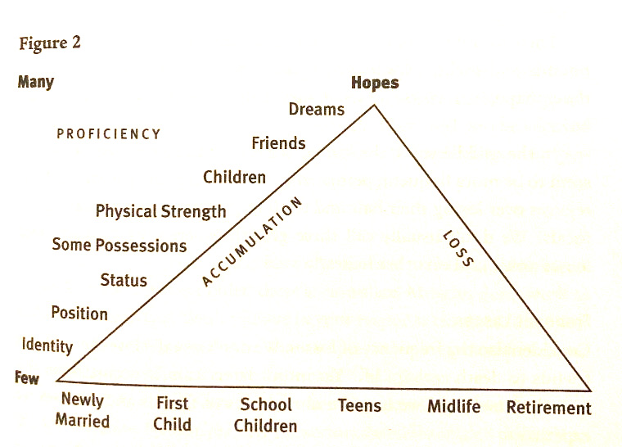
Lifespan
Gains losses

Slide 8

Understanding Grief
Grief is Normal:
Grief is Personal:
There is no “right” way to grieve
Different Types of Grief:
Many types and causes, and reactions
Grief Evolves
It’s a process

Slide 9
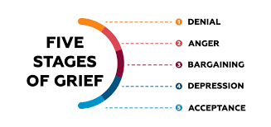
Notes:
Elisabeth Kübler-Ross in 1969

Slide 10

10 stage Westburg model of Grief
We are in a state of Shock
We express Emotion
We feel Depressed, lonely
We may feel physical distress
We may experience Panic
We feel a sense of Guilt
We are filled with Anger and resentment
We Resist returning to usual activities
Hope gradually comes through
We struggle to affirm reality
Notes:
Non linear

Slide 11
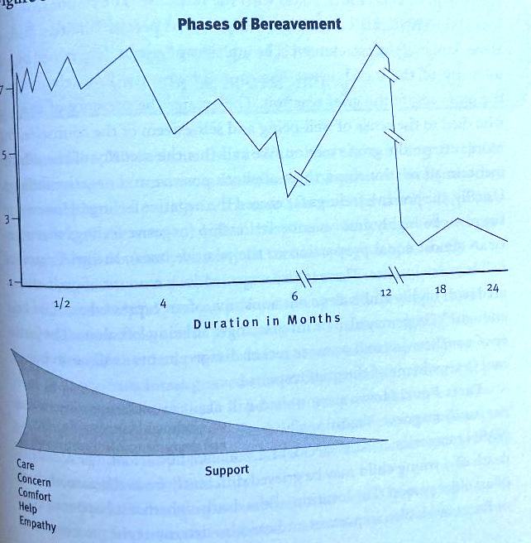
Spikes at
6-8 weeks
and one year
Wright H. Norman. Crisis & Trauma Counseling

Slide 12
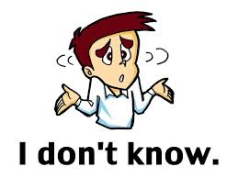
Its OK to be silent
Don’t minimize or use cliches
Make it safe to grieve openly
Be prepared!
What to say

Slide 13


Grief Intervention Stages
Crisis Mode
Initial Contact
Long Term Care

Slide 14
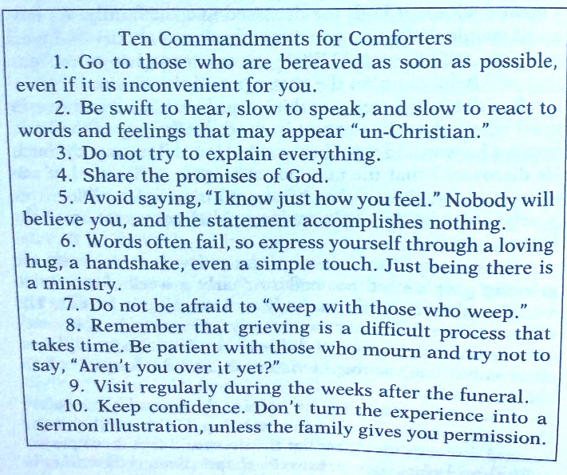
Ten Commandments for Comforters
Wiersbe, Warren. Comforting the Bereaved

Slide 15

Supporting Someone who is Grieving
1. Listen More Than You Speak
2. Acknowledge Their Loss
3. Offer Practical Help
4. Respect Their Need for Space and Time
5. Be Mindful of Their Emotions
6. Follow Their Lead
7. Respect Their Ways of Coping
8. Don’t Rush Their Healing
9. The Value of a Support Group
10. Offer Long-Term Support
11. Respect Cultural or Religious Differences

Slide 16

Suggested Books
Westberg, Granger. Good Grief
Baily, Joseph. The Last Thing We Talk About
Linn, Erin. I know Just How You Feel: avoiding the clichés of grief
Wiersbe, Warren. Comforting the Bereaved
Wiersbe, Warren. When Life Falls Apart
Wright H. Norman. Crisis & Trauma Counseling

Slide 17



Slide 18

Questions?

