Slide 1
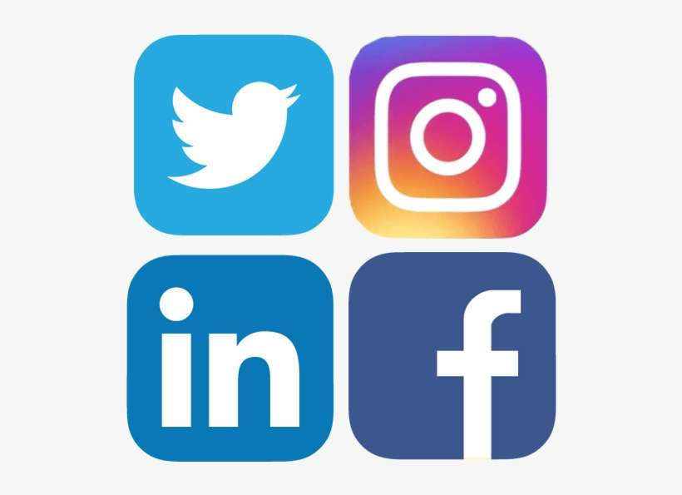
Social Media

Slide 2
Understanding Your Audience
The backbone of every successful social media strategy is social listening; which should be the initial step when launching your choice of the type of social media you will use.
What’s the best way to look for them? Match your social media platform to target demographics and the type of content you intend to create.
What methods do you use to target content? Recognize your own voice: keep your audience engaged, repeat it frequently and consistently.
Know your material: have a clear strategy in place that will meet your audience’s needs.

Slide 3
Comparing Social Media Platforms
What are some of the available platforms and how do they compare with each other?
Facebook, Twitter, Instagram, LinkedIn, YouTube
Facebook- 75% of male internet users and 83% of female users are active on Facebook; 22% of the world uses Facebook and stats from 2017 show Facebook had 2 billion monthly active users.
Twitter – 81% of millennials check Twitter once a day; it has 330 million monthly active users and 83% of the world’s leaders are on Twitter.
Notes:
The reason we are covering this is that you need to promote your Posts/Districts on social media. The question is what platform do you use? In order to earn All State and All American recognition you are required to have a Facebook page/group. However, you are not limited to Facebook. You can also use any of the other platforms to spread your message.
Facebook networks people and is a multi-purpose social networking platform. It allows users to chat with each other, share photos, and allows them to set up pages and/or groups. It has a broad appeal as 68% of adult Americans report using this platform. It undoubtedly reaches a larger demographic. People make connections on Facebook with friends, family, coworkers and other people they care to keep in touch with.
Twitter on the other hand is less about social relationships. It allows users to connect by following each other. In 2020, the total number of adults who use Twitter was 24%. Twitter is a fast-paced channel that appeals more to younger customers. This platform isn’t just popular with the average consumer. Journalists, politicians and celebrities all frequently use it too. Twitter is the place to find trending news – that could include the things you are doing in your communities or for veterans.

Slide 4
Instagram
Closely linked to all other social channels including Facebook and Twitter
Mostly supports visual content such as images and short videos
Offers “stories” and “albums” that can be great for events and campaigns
Engagement is up to 10X higher than on other platforms and is very popular with millennials
Ability to interact through comments
Can upload more than one image per post – a great way to tell a story
LinkedIn
Businesses and employed professionals build relationships using this platform
Includes informative materials related to industry niches, trades and professions
Allows sharing of interesting articles, opinion pieces and supports all content: video, images, written
Allows for active discussions in comment sections, discussion groups and through direct messaging

Slide 5
YouTube
Great for tutorials, how-to videos, demonstrations and even training. Supports video content.
Wide customer base – one third of all people on the internet are on YouTube and watch an average 40 minutes of video at a time
Engagement here can include calls to action in your video content, subscribers to your channel, leaving feedback and sharing of your video
Short length videos are more effective to get message across (and be shared). Under 1 minute, videos enjoy 80% viewer retention.
Videos 5-10 minutes long only have about 50% retention halfway through.
Consider using to share brief discussions about our VFW Programs, one at a time.

Slide 6
Content
Why is it important?
What is “sticky content?”
Content comes in two ways – Milestone and Always On
Content Formats
Written
Visual
Visual Infographic
Notes:
Ensures cohesiveness in our messaging; everything we put out should be consistent
Establishes our brand as it is our medium to express who we are, what we do and what we believe in
Increases visibility and thought leadership as an opportunity to package up our experience, expertise and perspective on topics and trends
Analyzes patterns in our audience; it’s an opportunity to see what they are interested in and where
Maximizes Return on Investment (ROI) as content development does not have to be an expensive endeavor and therefore can cost less, yet still reach a wide audience
Basically, it is content that we publish with the intent of getting users to engage with us
Focus on the main message, you don’t want to overwhelm your audience
Capture attention with something out of the ordinary
Provide examples and be relatable
Check your sources and back up your claims
Emotion drives sharing and encourages users to engage with your content
People like stories, create one for users to follow
Add value to the conversation, talk about what people want to hear not just what you want to say and tap into ongoing conversations to fill a gap
Milestone content is produced and published around a specific milestone
It is time sensitive, an announcement, an exhibition, a conference or event
Always On Content is not time sensitive that allows you to regularly and consistently publish
Updates, perspectives on issues or on trends
Written Content
Every tweet, post or update are forms of written content and will very by platform depending on requirements. Twitter has a limit of 140 characters. However, a blog provides for long form content and can help put more detailed information across (this should always be paired with visual content.
These can and should be written frequently, i.e., “on-the-road” style, blog posts, interviews, thought leadership articles, opinion pieces, story modules of a multipart series and business features – including news, business updates or events
Where can you use written content? Facebook, Twitter, LinkedIn, Blog/Website.
Visual
Includes photos, visuals and imagery from Posts or Districts. These can be designed elements or photographs from our/your media library or regional imagery banks.
Using visuals makes a post more aesthetically pleasing and improves its visibility, listing and shareability.
Use content from your Post/District to make sure you are using “owned” content, or share from external sources, but be sure to credit the content.
Always ensure the equipment and people in your images follow brand and safety guidelines.
Where can you share visual content? Facebook, Twitter, LinkedIn, Blog/Website, and Instagram.
Visual Infographic
Infographics can come in many formats; they can be long-form infographics that tell a story (i.e., a timeline) or one-off stats and facts (i.e., number of Post members statewide)
Why? It presents information in a concise, eye-catching, engaging and digestible manner, catering to an audience with a short attention span and lack of patience
There are free tools available to help you create infographics, but if you have access to a graphic designer to produce them that’s all the better.
Where can you share infographics? Facebook, Twitter, LinkedIn and Instagram.

Slide 7
Content Formats cont.
Visual Animated GIFs
Visual Videos
Visual Live Videos
Notes:
Visual Animated GIFs
A basic Graphics Interchange Format (GIF) is a static or animated image that is an incredibly useful social media tool
It’s often informal and humorous. They are a dynamic and lighthearted way to illustrate a message on social media
They can be produced through online generators
Where they can be used: Facebook, Twitter, YouTube and Instagram
Visual Videos
Moving images or media that can tell a story and transmit a message directly to the consumer
Easy to view and digest; passive watching versus active reading
Should be designed to be shareable.
They don’t have to be professionally done. Videos shot on smart phones can be very high quality
Where can you share to? Facebook, Twitter, YouTube, Instagram and LinkedIn
Live Videos
These are live feeds filmed and streamed in real-time; increasingly popular for covering events or conferences
Going “live” gives consumers immediate access to an event
How? You can include a live video by simply ensuring you have a camera, smartphone or other device connected to the platform you want to use
On Facebook, Instagram and possible on YouTube

Slide 8
Sharing Other’s Content
Reposting Content
Planning Calendar
Frequency of Posts
Notes:
Reposting Content
Social sharing is the practice of taking content from elsewhere (another person or organization) and reposting it or sharing it through your own.
This can be an image, video, article or a post
Remember when sharing others’ content you should cite the authors and may even need certain permissions
It’s also important to respect regional copyright laws
On Instagram, you need to cite the original source and tag the original source. If you can’t tag them, then type their name in the post
On Facebook, simply make sure to cite your original source if you feed their content to your own post
On Twitter,”retweeting” does not require any permission. Best practice is to add a comment or line of encouragement when retweeting to demonstrate active engagement as opposed to passive sharing
Planning Calendar
To plan where and when your content will be published
It will also be a simple overview of your social media activities
Frequency of Posts
The optimal frequencies of posting to content are:
Twitter – x3 posts per day
Facebook – x2 posts per day
LinkedIn – x1 post per day
Instagram – x1 post per day
Blog – x2 posts per week
This can vary depending on your resources
There are two elements to consider when it comes to posting on social media, Peak Time and Off-Peak Time
Peak Time – post when most people are online. This increases the chance of your audience seeing your posts on their newsfeed or timeline
Off-Peak Time – Post when less people are online. With fewer posts to compete with your posts you may receive more exposure as a result
Test your content at various times on various platforms and figure out what works best

Slide 9
All-State & All-American Requirement
Using Facebook for social media is the requirement in both programs
Notes:
Using Facebook
Decide if you will have a “page” or “group.” A page doesn’t allow for interaction with your audience, but they can send you messages via Messenger. A group allows for interaction with your audience and you can control certain aspects in your settings
No matter which you chose, your page or group should clearly identify your organization in name and cover photos
Your page or group MUST be apolitical
Your page or group MUST have its privacy set to public
There should be a good balance of content that you are sharing. Examples, sharing of National and Departmnt posts, news articles of interest to all veterans, posts about the various, important dates we’re required to recognize, services birthdays, events conducted at any level in the VFW or those of interest to veterans, what you are doing in your communities or for veterans, and meals, fundraisers, etc. happening at your Post homes, even if you don’t have a home.
You should follow as many VFW and veteran related pages or groups for content you can possibly share
Showcase yourselves!

