Slide 1
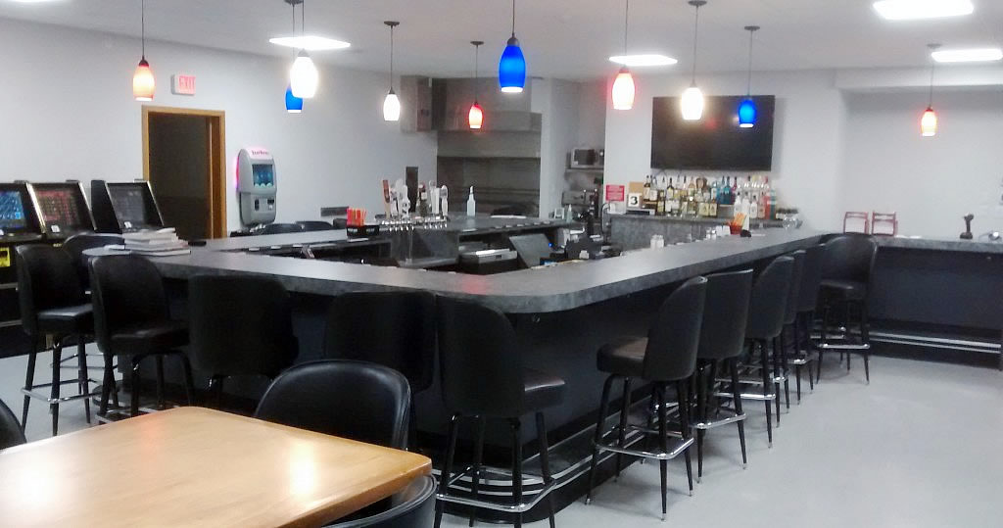
CANTEEN OPERATIONS
HOUSE COMMITTEES

Slide 2

Canteen Operations
Duties of Commander
Duties of Quartermaster
Duties of Trustees
Duties of House Committee

Slide 3
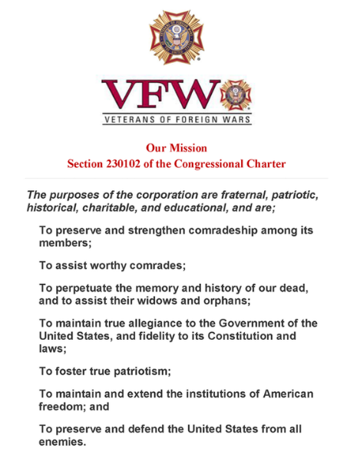
STATEMENT OF POLICY
First and foremost, consideration of Posts shall be to the purposes of the VFW which are fraternal, patriotic, historical, charitable, and educational.
Operation, management and control of Canteens are not provided for in our National Bylaws or Manual of Procedure.

Slide 4
HOWEVER,
Section 709 of the Manual of Procedure contains the following:
Any activity, clubroom, holding company or unit sponsored, conducted or operated by, for or in behalf of a Post, County Council, District or Department shall at all times be under the direct control of such post, County Council, District or Department and all funds derived there from shall at all times be under the control of such post, County Council, District or Department.

Slide 5

Section 709
Any Post owning and/or operating a canteen clubroom or other facility available to members or guests must maintain general liability insurance, including if necessary or appropriate, liquor liability insurance.

Slide 6
DUTIES OF POST COMMANDER
Provide Leadership
Help set Canteen Goals
Teamwork with House Committee
Knowledge in Canteen Operations
Knowledge of Profit & Loss
Compliance and Enforcement of Federal, State, County & City Ordinances and Regulations

Slide 7
DUTIES OF QUARTERMASTER
Understand Canteen Operations
Keep accurate Canteen Records
Receive and deposit all funds from Canteen
Disburse funds only when authorized
Work together with House Committee
Inform membership of status of Canteen regarding Profit or Loss

Slide 8
DUTIES OF QUARTERMASTER (cont.)
Makes the necessary Federal and State reports and payments for withholding taxes, Social Security and Unemployment Compensation. (Block 16 on Form 4212 questions)

Slide 9
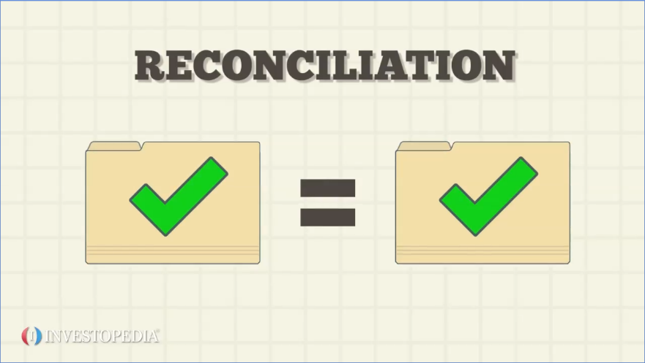
DUTIES OF TRUSTEES
Understand the opening/closing of Canteen operations
Check to see all payments are accurate to invoices or other bills

Slide 10
CANTEEN OPERATIONS
Bartenders daily log used & reviewed by?
Register Tapes saved daily and recorded?
Deposits done daily, weekly?
Separate deposits itemized for Canteen sales.
Canteen inventory done Monthly?
Canteen P & L reported Monthly by Canteen Mgr?
Canteen income and expenses are recorded on a designated column in ledger or similar?
Fed & State Withholding? EDD? Sales Taxes
Notes:
Presenter
2020-08-20 03:13:22
--------------------------------------------
Hold Up Roberts Rules of Order.

Slide 11

TO BE PROFITABLE
Control pricing/portioning of beverages
Using Volunteers
Active support by VFW Post Members, Auxiliary and Guests
Actively renting of Hall
Conduct Post Fundraiser/Events
Streamline Hours of Operation

Slide 12
COMMON CAUSES OF LOW PROFITS
Cost to pay for full time Manager or Employees
Poorly set Business Hours
Not charging enough/over pouring of drinks
Purchasing individual bottles vs. case
Not renting the hall
Free drinks (Illegal)
Embezzlement
Ringing up of sales/end of shift shortages
Notes:
Presenter
2020-08-20 03:13:22
--------------------------------------------
When we talk about reports here we are referring to but not limited to Trustee’s Quarterly Audits, Post Inspections, Community service, ALL committee reports and of course Report of Election. Commanders will be a member of All Committees – May not be the Committee Chairmen but a member nonetheless.

Slide 13
MONTHLY REPORT OF PROFIT & LOST
P & L monthly summary prepared by Canteen Manager
Report given at the end of the month to House Committee
Report then given to Quartermaster
Reported by Quartermaster at the next Post meeting

Slide 14

CANTEEN REGISTER
Daily Z out of cash register nightly
Bartender to complete Closeout Form
Attach Daily Z out slip to Bartenders daily Closeout Form
Verify closeout form $$ amount with Z closeout slip $$ amount
Keep all Z out tapes on file
Have a Cash Register with Continuous Grand Totals

Slide 15

CANTEEN INVENTORY
Should be taken monthly
Done by Canteen Manager
A Trustee will assist
Inventory from Canteen and Storage
Only have enough inventory to operate; don’t over purchase

Slide 16
CANTEEN MANAGER
Responsible to the House Committee for:
Management of the Canteen
Supervising employees/volunteers
Enforcing rules, BUT do not make them.
Accountable for receipts and expenditures
Makes reports to the Post Quartermaster and to the House Committee

Slide 17
HOUSE COMMITTEE
Functions only in a Post which operates a Post Home or Club (Canteen).
Members may be selected in anyway the Post determines (Elected/Appointed).
Members should serve staggered terms, on the order of Post Trustees.
Composition should be laid out in the Post By-Laws.

Slide 18
DUTIES OF HOUSE COMMITTEE
Generally, the House committee hires all employees, set their salaries, and issue necessary instructions and orders to the Canteen Manager.
Usually has the authority to suspend or discharge the Canteen Manager or any employee for good and sufficient cause.
Authority to suspend the Canteen privileges of any member/guest who violate the rules.
Enforce through the Canteen Manager, rules of decorum and behavior.

Slide 19
DUTIES OF HOUSE COMMITTEE (cont.)
The House Committee usually meets at least once a month for the purpose of discussing facility problems, taking inventory, studying financial reports and in general, acting as an advisory, supervisory and disciplinary board.
No member of the House Committee should ever be permitted to act as club manager or as a paid employee of the club due to obvious conflict of interest.

Slide 20
DUTIES OF HOUSE COMMITTEE (cont.)
Cannot make or enforce any rules contrary to the rules of the Department, public law, or the lawful instructions of the Post.
Committee is directly responsible to the Post floor and makes its reports to the Post at monthly meetings.
Refusal to comply is grounds for removal of any or all members of the Committee.

Slide 21
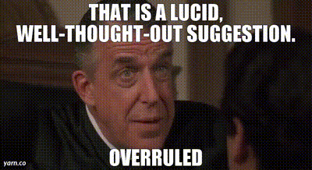
SUMMARY
It must be remembered that the VFW itself is paramount in any dispute. The Department rules and Post Bylaws and Canteen rules outline the way the Post and the Canteen must be operated. The Post, in all cases, is above the canteen. The canteen is merely an activity of the Post and must be treated as such.

Slide 22

QUESTIONS

