Slide 1
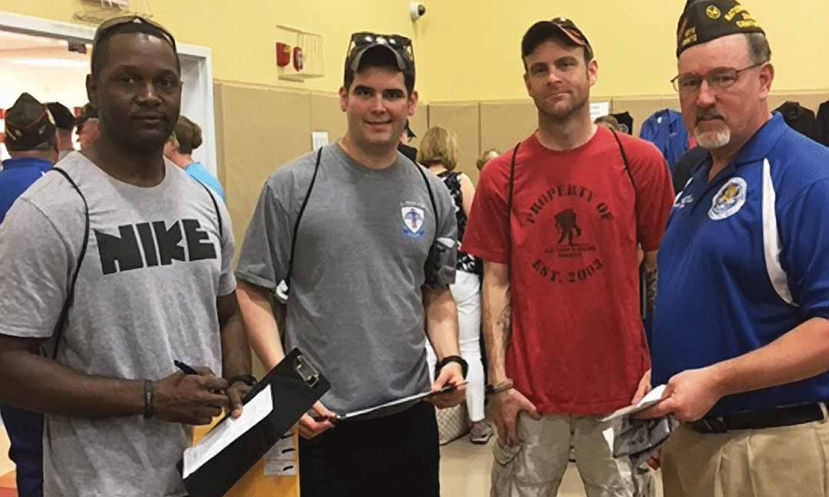
VETERANS OF FOREIGN WARS DEPARTMENT OF CALIFORNIA MEMBERSHIP & RECRUITING
“Let us strive on to finish the work we are in, to bind up the nation’s wounds, to care for him who shall have borne the battle and for his widow and his orphan, to do all which may achieve and secure a just and lasting peace among ourselves and with all nations”
-Abraham Lincoln

Slide 2
Keys to Membership Success
Our ability to:
Retain our current members, recover previous members, and recruit new members into our ranks,
Utilize all methods to deliver information and training to our membership,
Address our members needs and concerns,
Focus on the tenets of the VFW: take care of our members, their families, and the veteran community.

Slide 3
All State Program
Develop a “Post/District Membership Recruiting Plan” and submit to your District Commander and the State Adjutant by 09/30/21.
Must conduct at least two (2) membership drives/recruiting events by 05/01/22.

Slide 4
Utilize the “Recruiting Event Project Plan” to assist with your events!

Slide 5
Complete the “District/Post Recruiting Event Report” for each event held.
Submit via email to info@vfwca.org or mail to Department.

Slide 6
National Membership Program
Become familiar with criteria for All American
Strive for Recruiting Awards
Early Bird Award – VFW Legislative Conference award
New & Reinstated Member Award
Kansas City Spree
100% Post Award
100% Commander Drawing
Post Commander and Quartermaster Division Challenge
Legacy Life Membership Acquisition
Elite Recruiter
Recruiter of the Year

Slide 7
5 Steps to Effective Recruiting
Know the VFW Mission:
To foster camaraderie among United States veterans of overseas conflicts. To serve our veterans, the military and our communities. To advocate on behalf of all veterans.
Notes:
Introduction
Over the past several years, the VFW has been successful in recruiting new members into the organization. The only way to make this success permanent is to retain those members, recover past members, and continue to recruit new veterans into our ranks. To do this, we must improve the way we communicate with our members at all levels of the organization. Posts, Districts, and Departments need to use all methods available to convey information for news and training to our membership; newsletters, emails, social media, and outreach teams are some of the most effective ways to maintain communication with our members. We need to know who our members are and how we can address their needs and concerns. We need to focus on the basic tenets of our organization: to take care of our members, their families, and the veteran community as a whole.

Slide 8
2. Know Who We Are:
A nonprofit veterans service organization comprised of eligible veterans and military service members from the active, guard and reserve forces.
Founded in 1899 when veterans of the Spanish-American War and the Philippine Insurrection founded local organizations to secure rights and benefits for their service.
Today, membership stands at more than 1.5 million members of the VFW and its Auxiliary.
The VFW is the nation’s largest organization composed entirely of veterans who’ve served in a foreign conflict.
More than half of our new members since 2005 have been age 39 and younger.
Women veterans are one of the fastest-growing groups in our ranks.

Slide 9
3. Know the Membership Mission:
To recruit, retain and mentor a stable membership base including all generations of veterans.
To cultivate a membership that is well versed in institutional knowledge and actively involved at all levels of the organization and in the local community.
To establish Posts with an established vision of service, leadership and community outreach.

Slide 10
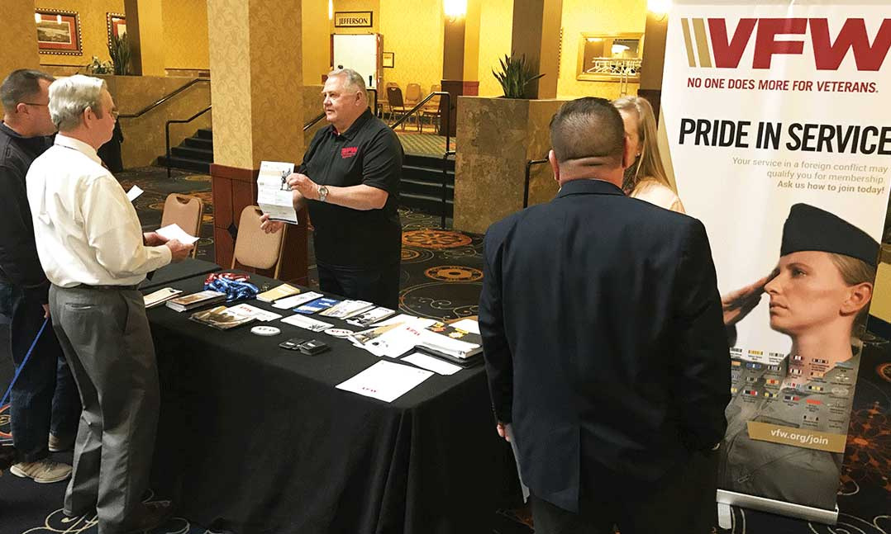
4. Listen to VFW top Certified National Recruiters
Talk to people with military or veteran gear
Relate to them
Don’t be afraid of “no”
Use the VFW Fact Sheet
Always have an application
Wear VFW gear
Put VFW card on cars in parking lots

Slide 11
5. Develop a Membership Toolkit:
Membership resources can be ordered directly from the Membership Department. It is located under Membership Quick Links when you log into vfw.org.
Eligibility Posters
Applications & Forms
Brochures
Training Videos and Webinars
Recruiting Tools
Attend Membership Monday training by National (Facebook)
Download the VFW App
VFW Fact Sheet

Slide 12
Electronic Documents
Forms and brochures can be downloaded from vfw.org
Membership Application
Fact Sheet
Eligibility Information Sheet
Recruiting brochures
Start an email membership campaign!

Slide 13
Recruiter Success Pocket Guide
Know the VFW – programs and purpose
Network for prospects
Make personal contact
Don’t be afraid to ask
Be persistent, not pestering
Look for common experiences
Listen carefully
Share your story
Be prepared
Enjoy yourself

Slide 14
Membership Campaigning on the Post level
Select a committee
Set a goal
Brief the committee
Compile a list – quartermaster
Publicize membership efforts – social media
Provide incentives & awards

Slide 15
Membership Resources
https://www.vfw.org/my-vfw/vfw-training-and-support/membership-recruiting-and-retention
National Members Service Center 1.833.VFW.VETS msc@vfw.org
Membership Department 1.888.JOIN.VFW membership@vfw.org
Recruiter Training Student Guide https://vfworg-cdn.azureedge.net/-/media/VFWSite/Files/MY_VFW/Training-and-Support/Membership/Recruiter-Training-Workshop-Guide.pdf?la=en&v=1&d=20191114T202912Z
Facebook https://www.facebook.com/VFWmembershipHQ
All State Program https://vfwca.org/uploads/Documents/Programs/All-StateProgram2021-2022(final).pdf
All American Program https://vfwca.org/uploads/Documents/Programs/VFWNationalMembershipProgram21-22.pdf

Slide 16
Questions?

