Slide 1
VETERANS OF FOREIGN WARS DEPARTMENT OF CALIFORNIA DISCIPLINARY ACTION
“Let us strive on to finish the work we are in, to bind up the nation’s wounds, to care for him who shall have borne the battle and for his widow and his orphan, to do all which may achieve and secure a just and lasting peace among ourselves and with all nations”
-Abraham Lincoln

Slide 2
Non-Disciplinary vs. Disciplinary Actions
Post Level:
710
Suspension
Personnel Actions:
Article IX

Slide 3
Bylaws Section 710
The Commander-in-Chief or Department Commander may require, within their respective jurisdiction, the inspection of any Department, District or Post, when they believe the best interests of the Organization will be served to ensure compliance with the National Charter, Bylaws, Manual of Procedure, et al.
They may detail any member whose duties shall be prescribed by the appointing power. Department will assign Deputy Inspectors.
All books, papers, accounts, records and proceedings pertaining to the VFW shall be subject to inspection at all times.

Slide 4
710 Inspection – Causes
Triggers
Member complaint to VFW Headquarters (National or Department).
At the request of the District Commander.
No Quarterly Audits submitted.
No Election Reports submitted.
Post meetings not being held.
Violations of City, County, State or Federal ordinances and regulations.
Non-compliance of VFW Bylaws and/or Manual of Procedure.

Slide 5
710 Inspection – Costs
Requests for a 710 will be considered on a case-by-case basis. Issues should be handled at the lowest level possible first.
Paid for by the Post or District.
Cost of Per Diem for each administrative committee member.
Cost of hotel accommodations and travel to/from the Post location.
Cost of postage for membership notification of any special meeting.
Cost to post/district continues for duration of the inspection.
How to Prevent a 710
Posts should notify the District Commander of problems.
District will send someone from the District to review and take corrective action.
If a Post requests help and the problem is corrected there will be no consequences.

Slide 6
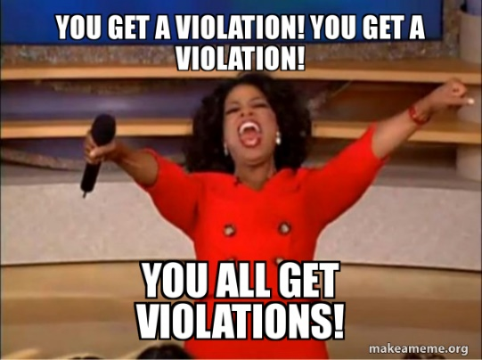
Manual of Procedure Section 211 - Suspension
Triggers – serious violations
Violations of VFW Bylaws and Manual of Procedures.
Vacant or unfilled officers positions.
Not holding meetings.
Failure in the performance of duties of Commander or Quartermaster as specified in Section 218 of the National Bylaws.
Violations of City, County, State or Federal laws, or ordinances.
Financial
Other

Slide 7
Suspensions
When a Post is suspended:
The Post Commander shall be notified in writing by certified mail.
No meetings shall be held except for the discussion of the resolution of the penalty.
No meetings are held without the Administrative Committee members present.
No funds shall be expended nor obligations incurred without the approval of the Administrative Committee.

Slide 8
Revocation
Revocation will occur when:
Any post with less than ten (10) members, or while under suspension the Post fails to establish a meeting quorum, or fails to elect the required officers, its charter shall be revoked and declared defunct with the issuance of a special order by the Commander-in-Chief.

Slide 9
Inspection by Department for Post Suspensions
At cost to Post/District.
To last 90 days (Can be shortened if deficiencies are corrected earlier).
Can be extended an additional 90 days.
Three to five Administrative Committee members assigned.
Special meetings will be called by the Administrative Committee to correct problems
Administrative Committee has complete control of the Post during suspension.

Slide 10
Article IX – Discipline
Reference: Podium Edition – Congressional Charter, Bylaws, Manual of Procedure, Ritual
Sec. 901 – Discipline of Members
Sec. 902 – Offenses
Sec. 901 – Procedure for Disciplinary Actions
Sec. 904 – Appeal
Sec. 905 – Suspension from Office
Sec. 906 – Prima Facie Case
Sec. 907 – Penalties
Sec. 906 – Administrative Actions

Slide 11
Sec. 901 – Discipline of Members
No member shall be subject to the penalties authorized in Section 907 unless such member has been advised in writing of the following:
Charges and Specifications, including and materials relied upon with respect to those charges,
Afforded the opportunity to request that such charges be heard and determined at a Disciplinary Hearing or otherwise resolved.

Slide 12
Sec. 902 - Offenses
Offenses recognized by the Veterans of Foreign Wars are:
Disloyalty to the United States of America.
Failure to fulfill the Member's Obligation as stated in the VFW Ritual or the obligations taken upon installation to any office.
False representation or deliberate concealment concerning eligibility for membership or for any office, or knowingly acquiescing in or permitting ineligible persons to become members or officers.
Disobedience or disregard of the provisions of the Congressional Charter, Bylaws, Manual of Procedure, Ritual or General Orders or any of the laws and usages of the Veterans of Foreign Wars of the United States or general orders of any Post, District or Department or the lawful orders of any Commander thereof.

Slide 13
Offenses: 5 - 8
5. Conviction of, or entering a guilty or no contest plea to, a felony, or to a misdemeanor or ordinance violation involving moral turpitude, in any court in the United States.​
6. Conduct prejudicial to good order and discipline or conduct unbecoming a member in their relations to the Veterans of Foreign Wars of the United States or other members.​
7. Divulging any of the private business of the Veterans of Foreign Wars of the United States or any Post, District, Department, without proper authority.
8. Preparing or signing any false record, return, order or other official document of or concerning the Veterans of Foreign Wars of the united States or an Post, District or Department, knowing it to be false, or making any other false official statement.

Slide 14
Offenses: 9 - 12
10. Aiding, abetting, counseling, concealing, commanding, conspiring, soliciting, procuring or causing to be done any act which, if done, would be punishable under this Article.
11. Knowingly conveying or causing to be conveyed in any form false information concerning military records.
12. Knowingly providing false information or statements in connection with the initiation of charges against any member or with respect to Disciplinary Actions under this Article.
9. Selling or otherwise disposing of money or property without proper authority or willfully or negligently damaging, destroying or losing any such money or property belonging to the Veterans of Foreign Wars of the United States, or any Post, District or Department.

Slide 15
Sec. 903 – Procedure for Disciplinary Actions
The Bylaws and Manual of Procedure outline, in detail the procedure for disciplinary action.
Preliminary Requirements with Respect to the Initiation of Disciplinary Actions.
b) Authority to Initiate Disciplinary Action.
c) Procedure for Initiating a Disciplinary Action.
d) Procedure if Summary Disposition or Disciplinary Hearing is not Requested.
e) Procedure for Summary Disposition.
f) Procedure if Disciplinary Hearing is Requested.
g) Resolution prior to Hearing or during Appeal.

Slide 16
Sec. 904 - Appeal
A member on whom Disciplinary Action is taken shall have the right to appeal such action.
Appeals to the Department Commander: For appeals initiated by a Post.
Appeals to the Commander-in-Chief: For appeals initiated by the Department.
Appeals to the National Council of Administration: For appeals initiated by the Commander-in-Chief.
More information is detailed in the Guide to Disciplinary Action which can be found on the national website.

Slide 17
Section. 905 – Suspension from Office
At any time after charges are initiated on a member holding office, the Commander-in-Chief or Department Commander having jurisdiction, may at their discretion suspend the accused member from an elected or appointed position pending a final decision on the disciplinary action that, with respect to salaried positions, said suspension will be with pay.
During the suspension of a Post, District or Department Commander, the office shall be temporarily filled by the Senior Vice Commander.
Suspensions are not subject to appeal.

Slide 18
Sec. 906 – Prima Facie Case
If an accused member has been convicted of a felony, misdemeanor or ordinance violation for conduct that subjects them to discipline under Section 902, certified copies of the judicial record or guilty plea shall be conclusive evidence.

Slide 19
Sec. 907 - Penalties
Penalties recognized by the VFW shall be:
Reprimand.
Suspension of certain rights of membership for a specified period of time.
Suspension or removal from office.
Suspension from membership for a specified period of time.
Termination of membership.
Other administrative actions deemed appropriate.
No penalty in a Disciplinary Action shall be effective if an appeal is current and not finally adjudicated.
The penalty shall be carried in affect by Special Order by the Commander-in-Chief or the National Council of Administration.

Slide 20
Sec. 908 – Administrative Actions
A member who has been suspended by a Post will be transferred to Department Member-at-Large. Upon completion of suspension, a transfer is permitted.
If a member transfers their membership and grounds exist to initiate disciplinary action for actions prior to transfer, the Department Commander or Commander-in-Chief may transfer the member back to the jurisdiction where disciplinary action is initiated.
Any member or former member sentenced will be allowed one opportunity to petition directly to the Commander-in-Chief to have their conviction pardoned or their sentence commuted provided at least five years of the sentence has been served.

Slide 21
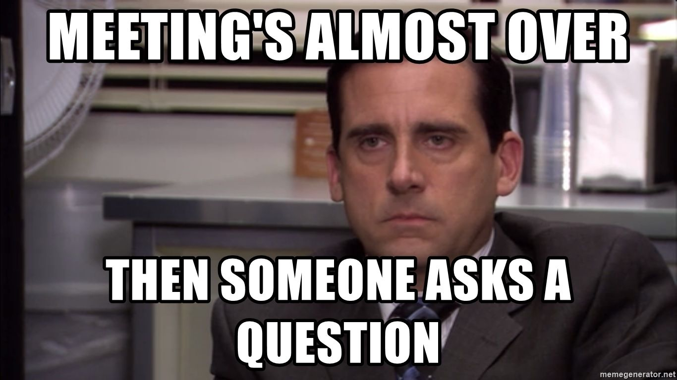
Questions

