Slide 1
VETERANS OF FOREIGN WARS DEPARTMENT OF CALIFORNIA Article IX – Discipline Sec. 903 – Procedure for Disciplinary Actions
“Let us strive on to finish the work we are in, to bind up the nation’s wounds, to care for him who shall have borne the battle and for his widow and his orphan, to do all which may achieve and secure a just and lasting peace among ourselves and with all nations”
-Abraham Lincoln

Slide 2
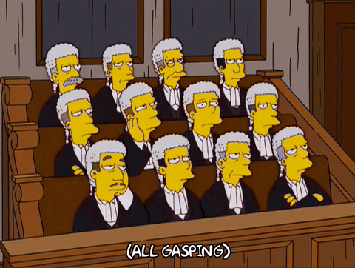
Discipline in the VFW
Discipline in the VFW is how we hold each other accountable.
Offenses are listed in Section 902 of the National Bylaws.
Does not apply when the intent is to suspend a member’s Post privileges (i.e. access to the canteen/clubroom).

Slide 3
Procedure for Disciplinary Actions
Preliminary Requirements with Respect to the Initiation of Disciplinary Actions
Initiated only when there are reasonable grounds to believe that an offense has been committed.
Requires an incident report, supporting documentation
Information submitted to: Post or Department Commander or CIC
2. An individual or Committee appointed to investigate and provides a written report.
3. Action cannot be initiated if a member has been the subject of ongoing or completed DA.

Slide 4
b. Authority to Initiate Disciplinary Action
A Post, by two-thirds vote at a regular or special meeting, instructs the Post Commander to initiate action.
A Dept. Commander may initiate action on any member in the Department.
The Dept. Council of Administration, by two-thirds vote, instruct the Dept. Commander to initiate action.
The CIC may initiate to any member in the VFW.
The National Council of Administration, by two-thirds vote, instruct the CIC to initiate action.

Slide 5
b. Authority to Initiate Disciplinary Action – cont.
6. If Commander fails or refuses to initiate action after being instructed, another member may be designated.
7. If the Commander is the accused, the action is initiated by higher authority.

Slide 6
(c) Procedure for Initiating a Disciplinary Action
Must be initiated by prep and delivery of written Charges and Specifications (C & S)
C & S issued and attached to a Special Order. The Special Order references the right to a Hearing or Summary Disposition and the rights of appeal.
C & S and Materials Relied Upon shall be prepared and delivered IAW Sec. 903.
Materials are delivered personally by registered or certified mail, return receipt requested and a copy to the next higher authority.
Prescribed forms are described in the Manual of Procedure.

Slide 7
(c) Procedure for Initiating a Disciplinary Action – cont.
6. Guide to Conducting Disciplinary Actions is available on the National website.
7. Initiating documents can be electronic if mutually agreed between the initiating officer and accused.

Slide 8
(d) Procedure if Summary Disposition or Disciplinary Hearing is not Requested.
If the accused does not request Summary Disposition or Disciplinary Hearing within fifteen (15) calendar days of receipt of Charges or Specifications, or
If the accused member, prior to the 15 day period advises the initiating member that a Summary Disposition or Disciplinary Hearing is not desired, or
Fails to participate in the procedures, then
The accused acknowledges the evidence and guilt and accepts the penalties and prescribed in Sec. 207, subject to the following provisions:
If initiated by the Post: a majority vote of the members must concur.

Slide 9
(d) Procedure if Summary Disposition or Disciplinary Hearing is not Requested – cont.
2. If initiated by Post: a majority of the Post must concur.
3. If initiated by Dept. COA: majority of the council must approve.
4. If initiated by CIC: majority of the National COA must concur.
5. If initiated by National COA: majority of the National COA must concur.
*Notification of penalties are mailed to last known address via registered or certified mail, return receipt requested.
*No appeal authorized if a Disciplinary Hearing or Summary Disposition is not requested.

Slide 10
(e) Procedure for Summary Disposition
If selected, the accused cannot contest the facts, but requests an assessment of the penalty by a Panel of members.
Must be requested in writing within 15 calendar days of the receipt of Charges and Specifications to initiating officer. Submitted to CIC within 5 calendar days.
The CIC shall appoint 3 members of the Committee on Appeals, 1 as Chairman. Members cannot be of same Dept/area as the accused.
The Assessment Panel may hear the matter electronically.

Slide 11
(e) Procedure for Summary Disposition – cont.
4. Disposition of Assessment Panel: The panel (separately) determines the penalty and the Chairman notifies the party & CIC.
5. No appeal is permitted provided the decision to terminate is subject and the CIC concurs.

Slide 12
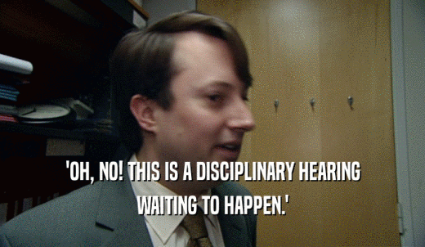
(f) Procedure if Disciplinary Hearing is Requested
The accused must request a hearing within 15 calendar days of the Charges and Specifications.
The Disciplinary Hearing is outlined in the Guide to Conducting Disciplinary Actions.
If accused fails to appear, that action continues as if no hearing had been requested.

Slide 13
(g) Resolution prior to Hearing or during Appeal
The Prosecutor, Panel President and accused may enter into an Agreement to resolve the Disciplinary Action.
There is no appeal.
A copy of the Agreement is forwarded by the initiating officer to the CIC.
(h) The Adjutant General prepares forms to facilitate actions.
Computation of Time:
Time is computed as calendar days unless the action falls on a Sunday or National Holiday.
If so, it is on the next calendar day.

Slide 14
Questions

