Slide 1
VETERANS OF FOREIGN WARS DEPARTMENT OF CALIFORNIA PROPER BONDING PROCESSES

Slide 2
BONDING REQUIREMENTS
National Bylaws Section 703
Each officer accountable for funds or property pursuant to any provisions of these Bylaws shall be bonded with an indemnity company as surety in a sum at least equal to the amount of liquid assets.
National Manual of Procedure, Section 218(a)(5)
The Quartermaster shall qualify and secure a bond equal to liquid assets.
Notes:
Presenter
2020-08-20 03:12:24
--------------------------------------------
And by all means – If you are Not wearing Pants please do Not Get up unless you turn off your video.

Slide 3
BONDS – ACCOUNTABLE OFFICER
Who needs to be bonded?
Any and All Post Officers who have access to the Post Funds (on bank signature card).
The position, not the person is bonded.
How much should you be bonded for?
Enough to cover liquid assets. Rule of Thumb: Should be slightly more than your quarterly audit total.
How much does a bond cost?
$4 per thousand with a minimum of $3,000 in coverage.
Can I increase my bond coverage?
Yes, you submit a Request for Bond Increase application and pay the difference between the two amounts.

Slide 4
BONDS – CLUB EMPLOYEES
Who needs to be bonded?
Any club employee who is responsible for money. Canteen manager, Bingo Chair.
The person, not the position is bonded.
How much should you be bonded for?
Enough to cover what they normally are in custody of until given to QM.
How much does a bond cost?
$5 per thousand with a minimum of $3,000 in coverage.
What happens if the Canteen Manager is replaced?
You will need to submit a new application and pay for a new bond.

Slide 5
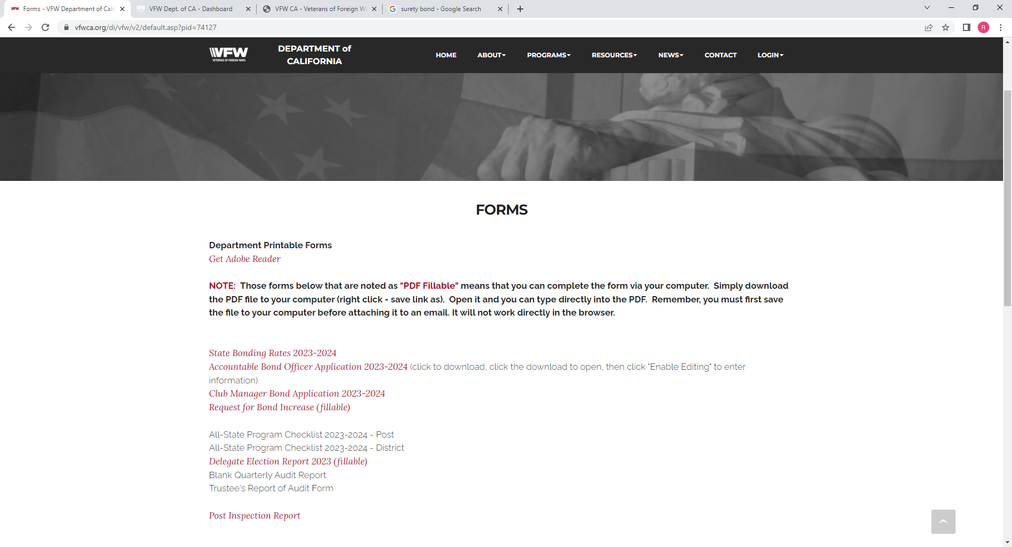
WHERE DO YOU FIND THE BONDING INFO
The information and documents you need to complete the bonding process are located on the Department website (www.vfwca.org) at https://vfwca.org/di/vfw/v2/default.asp?pid=74127 .

Slide 6
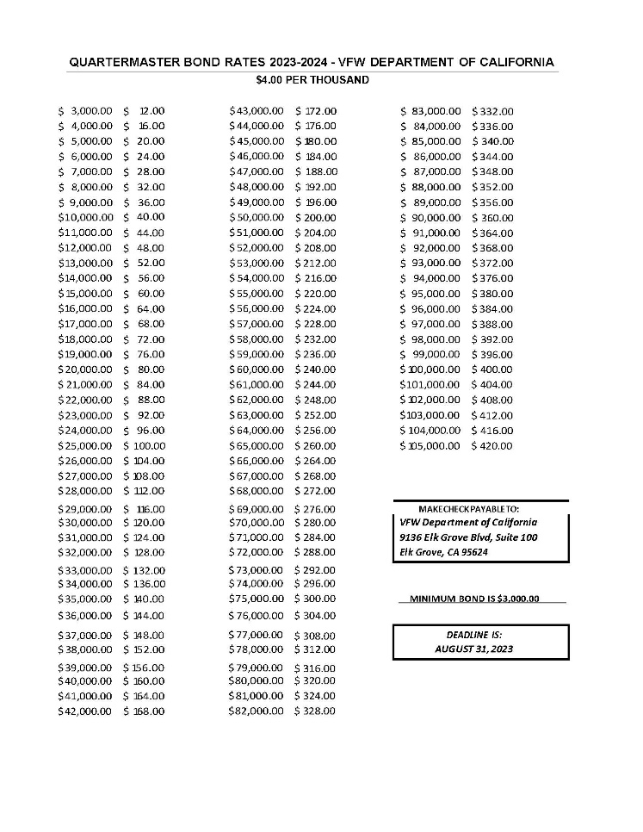
BONDING RATE SHEET – Accountable Officers
Accountable officers (Commander, QM, Asst. QM, etc. will be bonded at $4 per thousand.
Club employees (canteen manager, bingo manager, bartenders, etc. are bonded at $5 per thousand.
Make sure you use the correct bonding rate sheet!

Slide 7
ACCOUNTABLE OFFICER APPLICATION
Click on the link to download the document.
Click the download to open in Microsoft Word.
Click the “Enable Editing” button to allow you to enter the information in the boxes.

Slide 8
ACCOUNTABLE OFFICER BOND APPLICATION
Make sure to use the proper application
Date on the form should read August 1, 2024
DO NOT use the Club Employee form for VFW Officers

Slide 9
COMPLETING THE APPLICATION
Enter the Post number and the State, “CA”
Enter the amount of the bond, not the amount the bond costs!
Enter the position being bonded. ONLY ONE position per application.
Enter the Post’s annual income and the date you are completing the form.
Enter if the Posts has filed a claim in the past three (3) years.
Enter the phone number and address.
AGAIN, make sure you are using the current application!

Slide 10
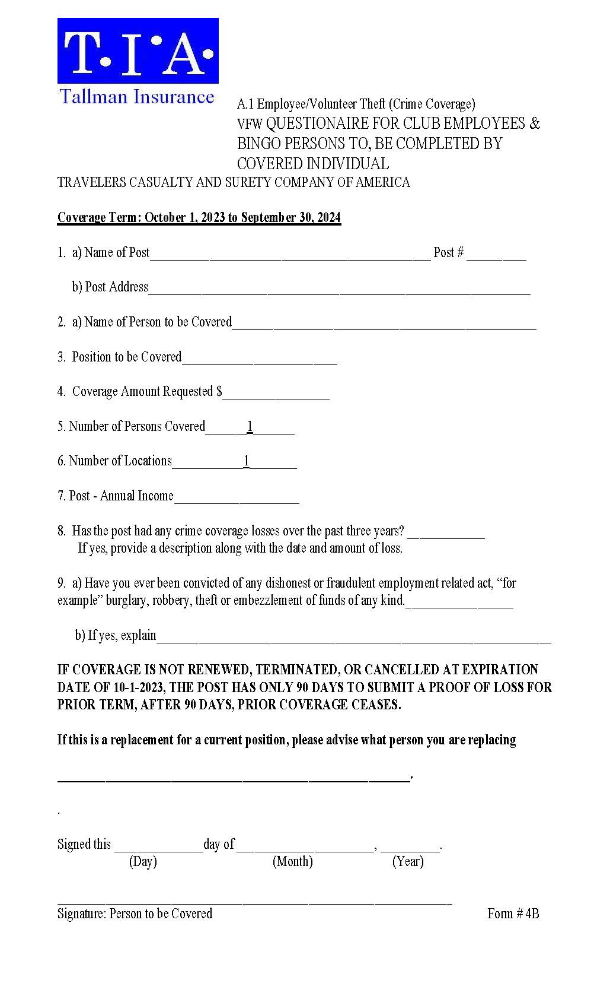
CLUB EMPLOYEE BOND
Make sure you are using the VFW Questionnaire for Club Employees & Bingo Persons.
Are you using the current form and not one from 2005? Coverage Term should state October 1, 2024 to September 30, 2025.
Fill in the application and it must be signed by the person who is going to be covered.

Slide 11
QUESTIONS

