Slide 1

Dashboard Reporting for Chaplains

Slide 2


Why we report
What to report
How to report

Slide 3
Reportable (representing the VFW)
Not reportable
Attending or conducting funeral services
Meeting for counseling outside of post functions
Home & hospital visits
Community events representing VFW
Post meetings or conventions
Serving friend of family member
Service for other organizations or church
Attending a veteran’s event if not
Representing VFW

Slide 4

1. Start by going to your dept webpage
2. Log in here

Slide 5
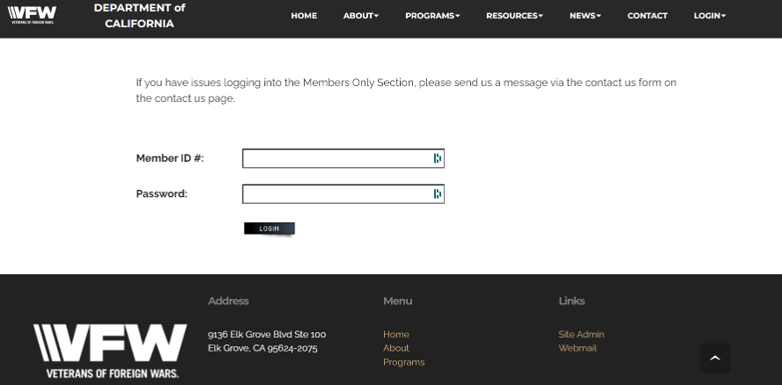

Member number
Last name all lower case

Slide 6
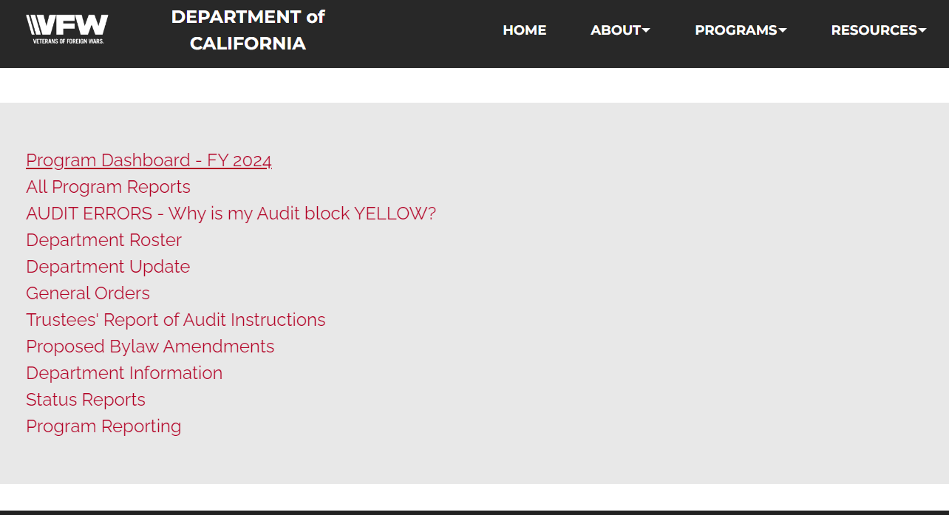
To view dashboard reports

Slide 7
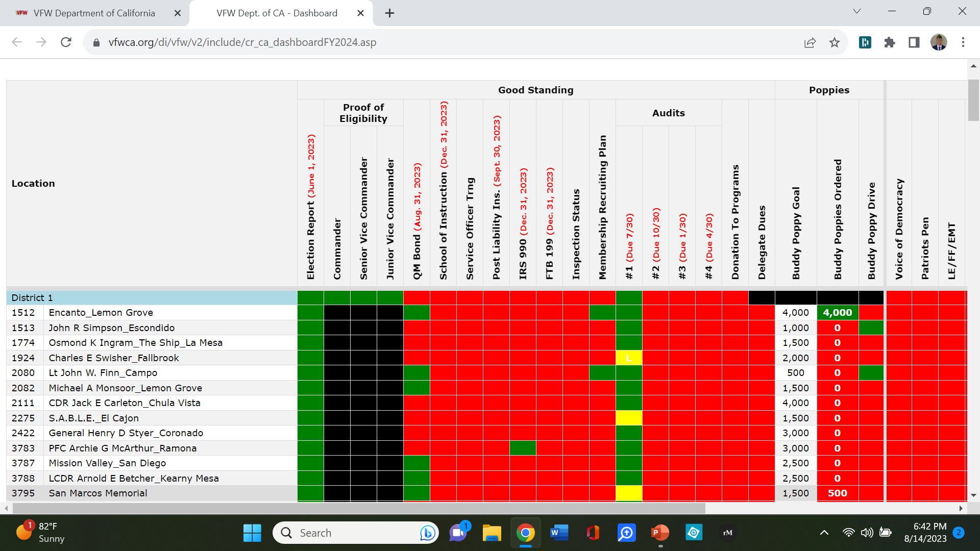
VFW Dept Dashboard Reporting
Dashboard: scroll right to see community service & Vet assistance

Slide 8
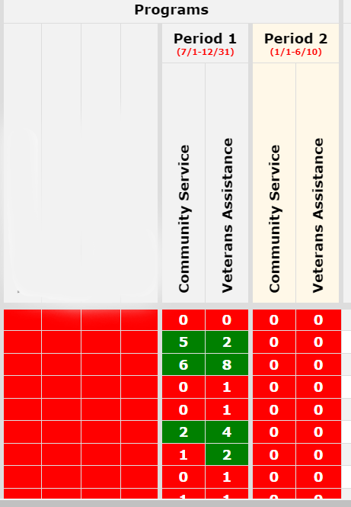
2 categories
Community Service
Veterans Assistance

Slide 9
Enter your reports here

Slide 10
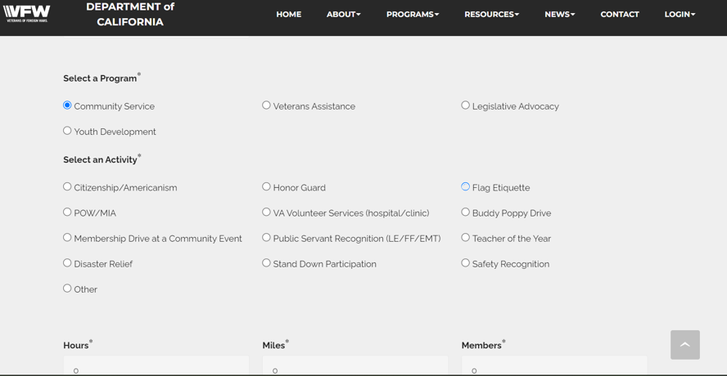


Select one
Select one
Notes:
Each one has a few options. Most often the chaplain’s work doesn’t have an activity listed so use “other”

Slide 11
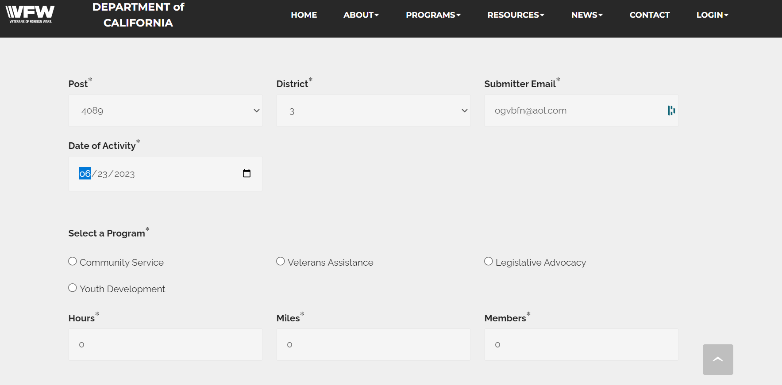
Top 2 rows are automatically filled out for you
Select one category and insert the bottom row information
Notes:
By post only. Only one entry per event regardless of participants

Slide 12
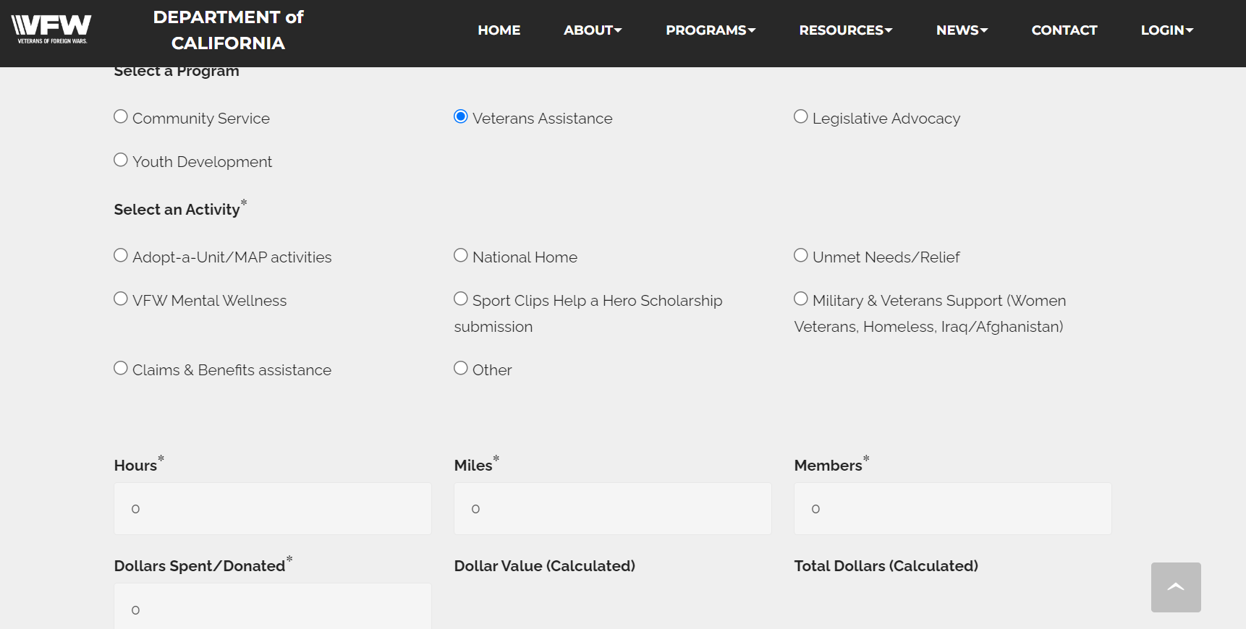


Most common choice since chaplain’s
work doesn’t fit the limited categories

Slide 13
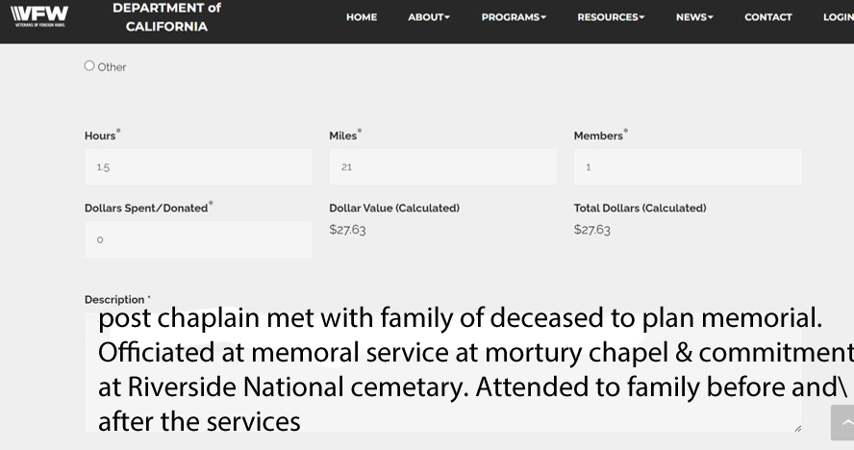
Please be descriptive, specific, don’t assume readers
know what you mean

Slide 14
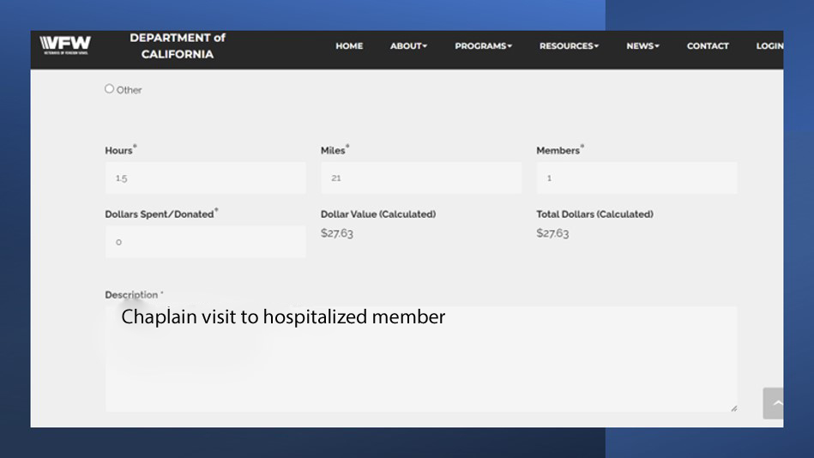
Spent time comforting sick member
Contacted member’s home church per his request

Slide 15

Questions?

Slide 16



