Slide 1

VFW Chaplains Training
Confidentiality & Communication

Slide 2
Chaplains Workshop 17 June 2026 12:30-14:00
Department of CA Convention
Effective Communication Principles
Confidentiality Guidelines & Laws
Update on Prayers
Q&A Session

Slide 3


Slide 4
Confidentiality Issues
Moral
Legal
Credibility
Protection of the chaplaincy

Slide 5
confidentiality
Trust
Reputation
Effectiveness
Promotion of chaplaincy

Slide 6
What is Mandated reporting?
the legal obligation for certain professionals to report suspected abuse or neglect of children, elders, or dependent adults

Slide 7
What must be reported?
Child abuse: This includes physical, sexual, and emotional abuse, as well as neglect.
Elder and dependent adult abuse: This includes abuse, neglect, and financial exploitation of individuals who are 65 or older, or adults who are 18-64 with physical or mental limitations that restrict their ability to protect themselves.

Slide 8
Who are mandated reporters?
Physicians
nurses
teachers
social workers
law enforcement officers
caregivers
Clergy (chaplains)

Slide 9
Who to report to?
Law enforcement
Child protective services
Adult protective services

Slide 10
When in doubt report it!
You will usually be legally protected if you do
You can be held legally liable if you don’t

Slide 11

Don’t share any personal information without their, or family’s, permission.
Ask if you can share

Slide 12

101

Slide 13
THE WAYS WE COMMUNICATE
Every message has three components
1) the actual content, (the facts) 7%
2) the tone of the voice 38%
3) the nonverbal communication 55%

Slide 14
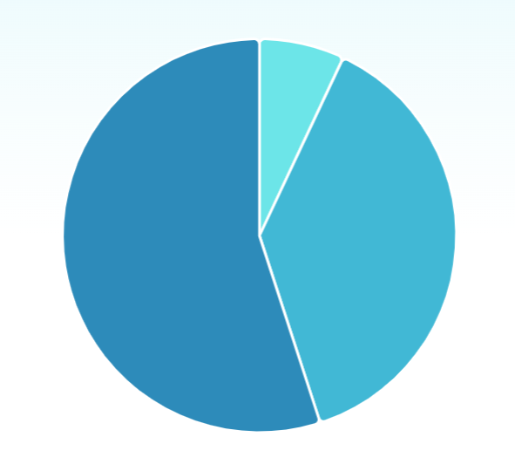
words
nonverbal
tone
Notes:
A more visual way to look at the 3 components in perspective.

Slide 15
Active Listening skills
Focused deliberate listening
Positive cues
Reflection
Avoid simple questions
Have no agenda
Never Minimize

Slide 16

OPEN AND CLOSED QUESTIONS

Slide 17
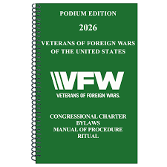
Prayers Revisions in Podium Edition
…………without Thee You our efforts are vain. Continue Thy Your blessings upon us and our families, we pray Thee,. and guide us during our deliberations. We beseech Thee, ask You O God, to bless the dependents of our departed comrades

Slide 18

Prayers
Changes to Podium Edition
Options: a. use verbatim,
b. modify prayers
c. write your own
3. Always be prepared
4. Shorter is better

Slide 19



Slide 20

Questions?

